Slide 1
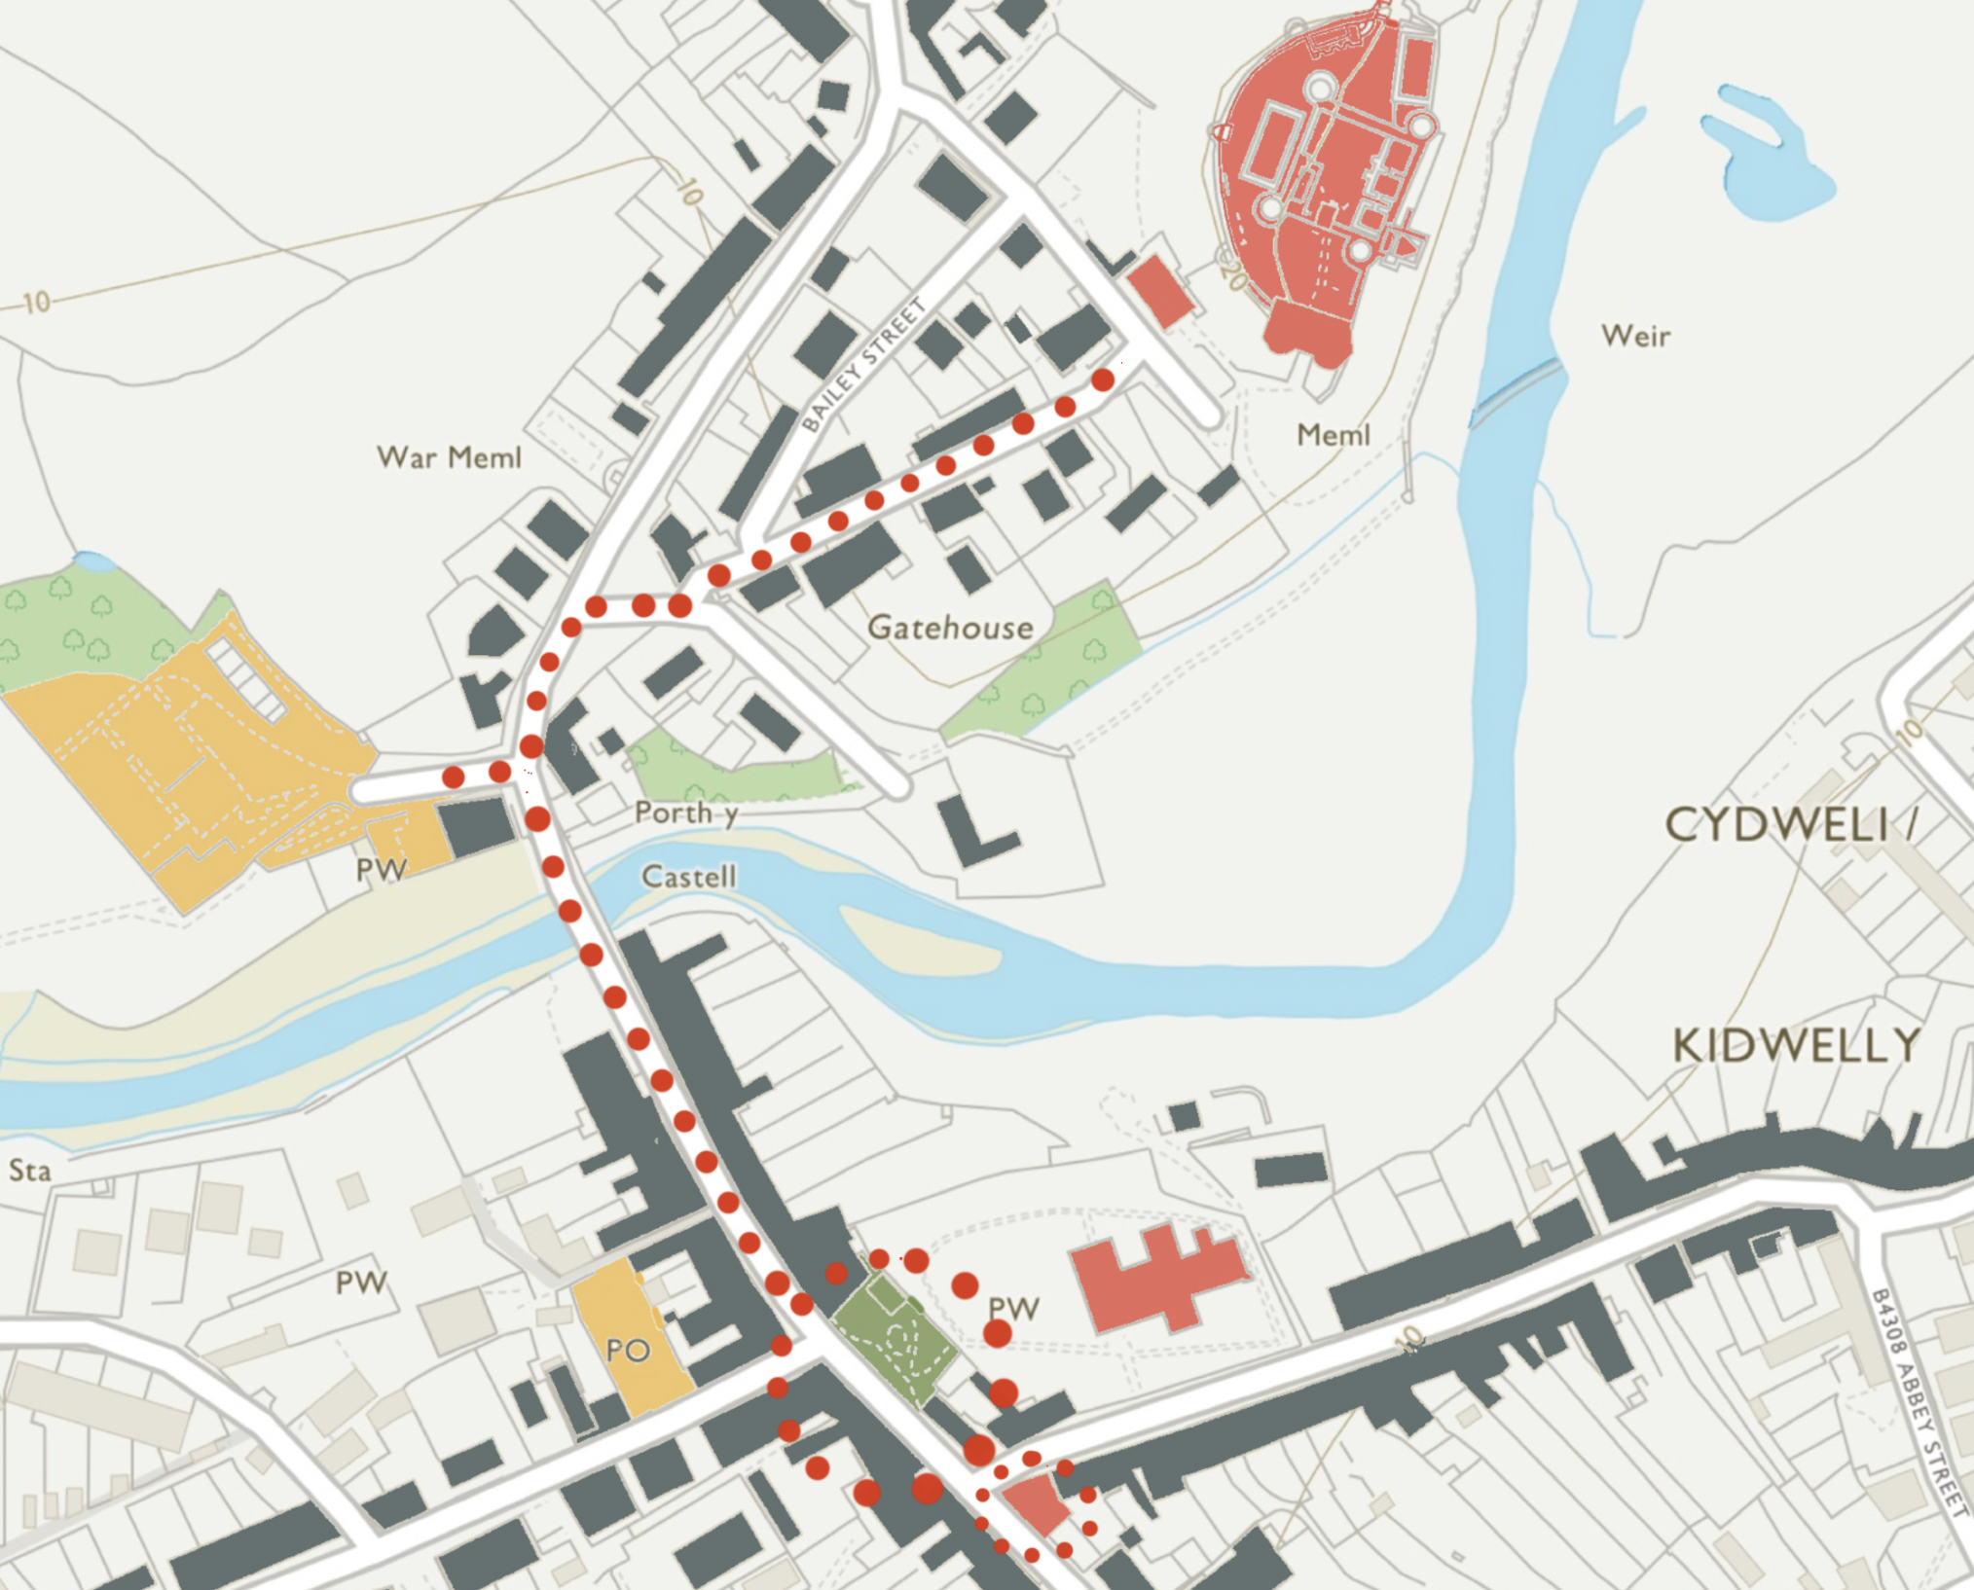


Kidwelly
Sustainable Economic
Growth Plan
Kidwelly
Sustainable Economic
Growth Plan
November 2021

Slide 2


SUSTAINABLE ECONOMIC GROWTH PLAN
Kidwelly – Sustainable Economic Growth Plan
Final
THIS DOCUMENT HAS BEEN PREPARED BY OWEN DAVIES CONSULTING & CHILMARK CONSULTING ON BEHALF OF CARMARTHENSHIRE COUNTY COUNCIL
All maps within this document are:
Reproduced from Ordnance Survey with permission of the controller of Her Majesty’s Stationary Office (C)
© Crown copyright and database rights [2020] Ordnance Survey 100023377
Unauthorised reproduction infringes Crown copyright and may lead to prosecution/civil proceedings.
OWEN DAVIES CONSULTING LTD
7A NEVILL STREET ABERGAVENNY,
NP7 5AA

Slide 3
SUSTAINABLE ECONOMIC GROWTH PLAN
Contents
1 – Purpose 4
2 – Plan area 5
3 – The bigger economic picture 6
4 – The key issues 8
5 – Draft vision and objectives 9
6 – Priority actions 11
7 – Funding & delivery 23

Slide 4
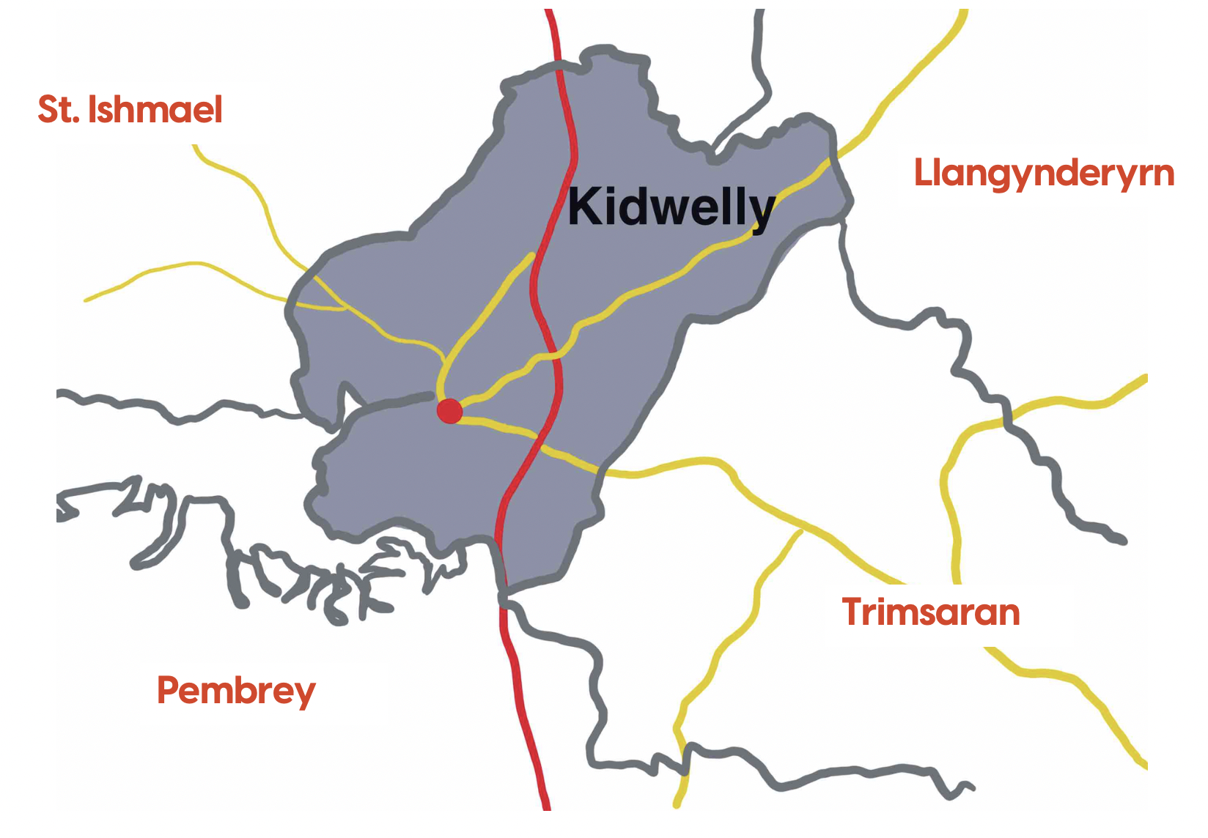
SUSTAINABLE ECONOMIC GROWTH PLAN
1 - Purpose
This Sustainable Economic Growth Plan for Kidwelly is concerned with economic recovery following the pandemic as well as the longer-term prosperity and growth of the town and surrounding area over the next five years and beyond.
The purpose of the Plan is to provide a long-term strategic vision and to set out detailed proposals to achieve economic sustainability and growth. Aiming to create new employment and stronger economic performance which in turn will lead to the social, environmental, and cultural sustainability of the town and surrounding feeder communities.
The Plan is being prepared as part of Carmarthenshire County Council’s Ten Towns Initiative and is being delivered on behalf of the Carmarthenshire Local Action Group (LAG). It is part funded by the Rural Development Plan for Wales 2014-2020, which is funded by the Welsh Government and the European Agricultural Fund for Rural (EAFRD).
This final plan has been through public consultation and is designed to be accessible and focused on the core themes and priority actions. Further details can be found in the Baseline Performance Vitality and Viability Report produced in February 2021, particularly for the socio-economic context of the town and region.
Figure 1 Study area and location context

Slide 5
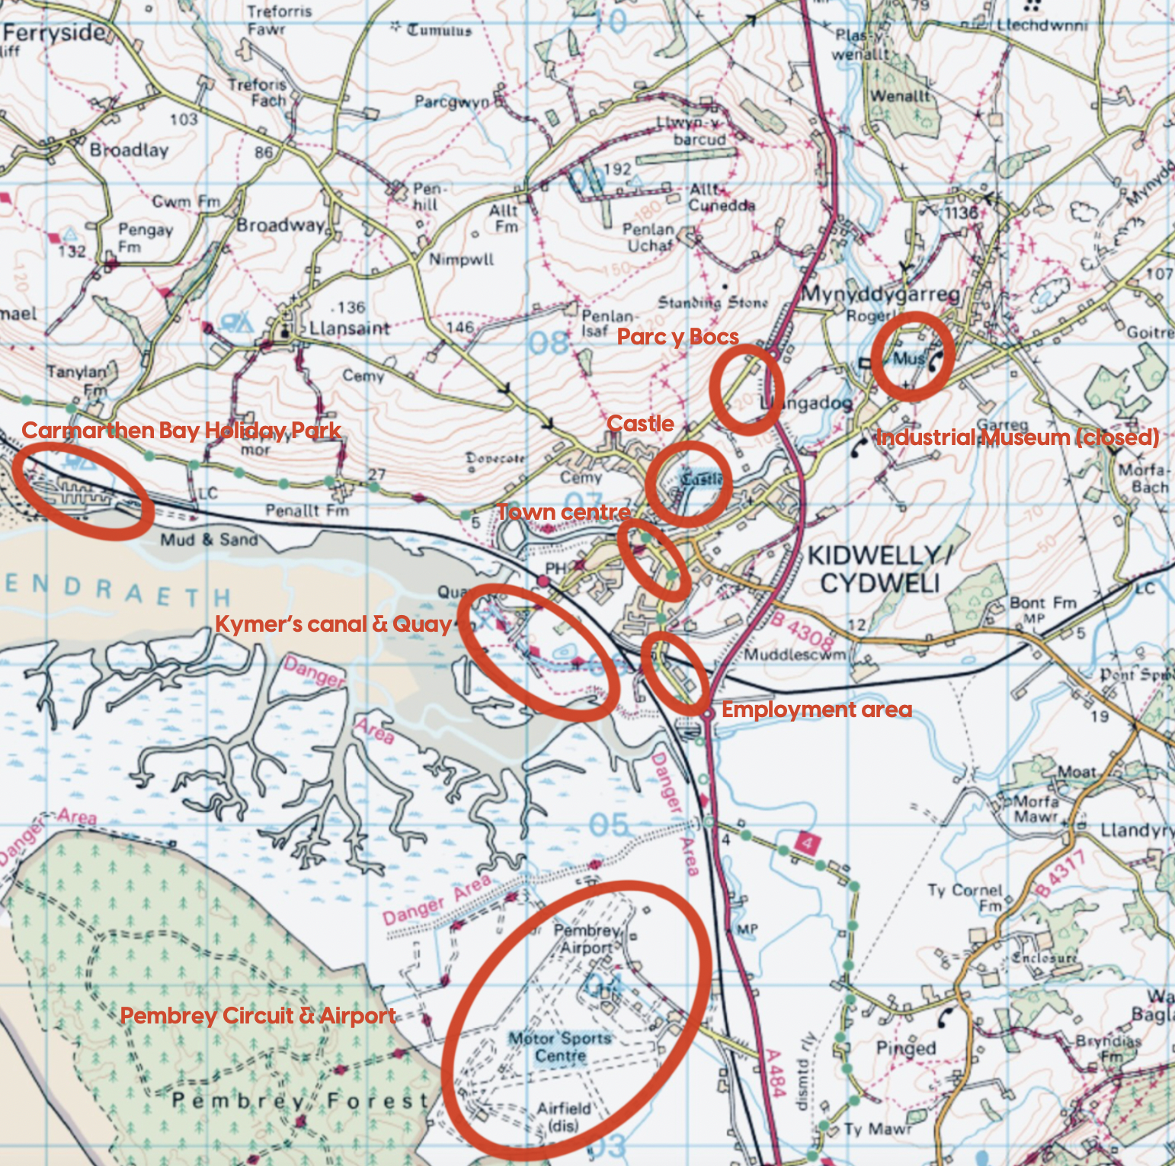
SUSTAINABLE ECONOMIC GROWTH PLAN
2 – Plan area
Kidwelly is a historic coastal town located on the Gwendraeth River with a well-known and attractive castle and compact town centre. The area includes the community of Mynyddygarreg and has a growing yet aging population of some 3,660.
Kidwelly has a strong medieval and subsequent industrial history including the historic Kymer’s Canal, the Quay and the former industrial museum. There are high profile local businesses including Gravells and Burns alongside nationally owned businesses such as Carmarthen Bay Holiday Park (Park Dean Resorts), Travis Perkins and Co-Op.
There are numerous business and enterprises found in the surrounding area as well as major economic assets including the nearby Pembrey motor racing circuit and airport. The local economy is however heavily reliant on retail, hospitality, and accommodation businesses and is dependent on nearby Carmarthen and Llanelli for higher order shops, services, and larger employment opportunities.
Figure 2 Plan area context

Slide 6
SUSTAINABLE ECONOMIC GROWTH PLAN
3 – The bigger economic picture
The economic picture for Kidwelly is heavily influenced by the plans for the recovery of the Carmarthenshire economy following the Coronavirus pandemic and the longer-term strategic priorities for the County and Swansea Bay City Region.
There are two main pillars for the recovery of the Carmarthenshire economy which are focused on local level actions and growing the competitiveness of the whole economy including support for Business, People and Place. There are also four cross-cutting recovery themes:
Ultra-reliable digital connectivity and a digital culture – underpinning recovery and growth across the whole economy;
Skills – retrain, re-skill, up-skill and ensuring that people have the right skills to do the jobs created;
Green economy – low carbon and climate-resilient infrastructure, renewable energy and sustainable homes; and
Fair and equal economy and support for the Welsh language and culture.
Figure 3 Economic recovery pillars for Carmarthenshire

Slide 7
SUSTAINABLE ECONOMIC GROWTH PLAN
The strategic context of the plan has been summarised in the following diagram and reflects the priorities of Carmarthenshire CC, the Swansea Bay City Region and the Welsh Government, along with the growing influence of the Well-being of Future Generations (Wales) Act and local Well-being Plans.
A key aim of the Act calls on public bodies to be more agile to ensure they can respond to ever-changing economic circumstances and to maximise new opportunities for growth. Sustainable development is applied throughout, as well as new ways of working, ensuring that local authorities take account of the long-term, prevent problems occurring or getting worse, take an integrated and collaborative approach, and involving people.
Figure 4 Strategic influences

Slide 8
SUSTAINABLE ECONOMIC GROWTH PLAN
4 – The key issues
A baseline analysis of the Kidwelly area has been completed, which has identified the following key strengths, weaknesses, opportunities, and threats (SWOT) and evaluated the current performance of Kidwelly before preparing a new plan. The purpose of the SWOT analysis is to find out what's working well, and what's not so good. It also looks at how the town might wish to grow, and how it might get there; as well as what might get in the way.
Figure 5 Kidwelly SWOT analysis
Key strengths Growing population Key local ‘grounded’ employers including Gravells and Burns Kidwelly Castle and the attraction of c.30,000 visitor a year Wider heritage and visitor attractions including Kymer’s Canal and Quay, St Mary’s Church, Parc y Bocs, Carmarthen Bay Holiday Park and Pembrey airport and motor racing circuit Rail station with direct links to west Wales, Carmarthen Swansea, Cardiff, and Manchester Wales Coast Path, National Cycle Route and extensive walking trails High levels of community activity, organisations and local engagement | Key weaknesses Aging population Hidden pockets of high socio-economic deprivation within the town Higher than average economic inactivity and low levels self-employment Range and attractiveness of town centre business and attractions Small number of micro businesses Reliance on food, drink, accommodation and hospitality Reliance on Llanelli and Carmarthen for employment Range and availability of employment space particularly for small businesses Prominent vacant buildings / sites Low levels of visitor spend. Lack of the visual use of Welsh, Welsh speaking staff and Welsh speakers establishing their own businesses.
Key opportunities Recently secured Coastal Communities Fund supporting local marketing and branding initiatives, events and the growth of the local economy Proposals for reopening the Industrial Museum and new town centre heritage visitor attractions Investment to expand and create new enterprises by key local business Re-purposing existing key sites and buildings Investment available for SMART town infrastructure and digital technology Stronger links between the hinterland, accommodation providers and the town and its attractions Support available for the circular economy and local energy generation | Key threats Longer term economic and social effects of Covid-19 Diversion of local business investment towards larger nearby centres e.g. Carmarthen and Llanelli

Slide 9
SUSTAINABLE ECONOMIC GROWTH PLAN
5 – Vision and objectives
The Plan has been drafted at a time when there remains a high level of uncertainty around the nature of the economic recovery following the pandemic as well as the impacts (both positive and negative) of Brexit. The recovery is likely to be gradual and it may take many years for the economy to recover to its previous level.
In addition to the Government and Carmarthenshire’s focus on protecting jobs and safeguard businesses, there needs to be a longer-term focus on challenges that constrain growth and economic opportunities in Kidwelly. These include many of the challenges faced by rural communities including aging populations, low level of entrepreneurship, productivity and wages, skills deficits, too few businesses ‘scaling-up’, and the need for investment in modern business infrastructure and premises.
The vision set out here contains a series of priorities and proposals for a sustainable thriving Kidwelly economy that supports a vibrant well-connected town and rural community that is appealing to all, including young people and families. Kidwelly should become a place where good jobs are attainable, new business start-up and the small number of major local businesses already grounded in the community are encouraged to grow. We picture a more diverse and appealing place to visit throughout the year that maximises the advantages of the special local heritage and natural environment as well as local culture and Welsh language.

Slide 10
SUSTAINABLE ECONOMIC GROWTH PLAN
Objectives
The following objectives should be supported and delivered through the actions evolving from this Plan.
Business - retain, support, and attract new businesses
Diversify the economic base and broaden the range of business sectors and employment opportunities available throughout the year. The key growth sectors for the economy include advanced manufacturing and engineering, creative industries, green economy, agriculture, and food production.
Improve the quality and strengthen the links between hospitality, retail, accommodation, and cultural/leisure business that have the potential to grow and add value by extending the breadth of the town and surrounding areas visitor economy
Create new workspaces and reuse surplus buildings to encourage entrepreneurship, start-up, and grow-on business
Encourage the growth and investment of the major local businesses that are already grounded in the Kidwelly area and help them to provide good quality and skilled local employment.
Promote the local supply and sale of agriculture, food processing and locally manufactured goods
Encourage businesses that grow the circular economy and initiatives that support the transition to a low carbon economy.
People – encourages entrepreneurship, support business skills and training
Support the up-skilling of those in work in target sectors, such as improved digital skills
Ensure self-employed, traders and micro firms are supported in developing their business skills and the confidence to grow e.g. support for business planning, digital skills, marketing skills, etc.
Support the use of Welsh language skills in the workplace and strengthen the links between language and economic development.
Place - invest in improving the public realm, key buildings and infrastructure
Improve the town’s public realm to make it feel more integrated, welcoming, pedestrian friendly and create the conditions to encourage existing businesses to grow and for new business to start-up
Find new uses for prominent unoccupied buildings that strengthen the economy
Improve the quality, consistency and location of visitor signage and information to intercept more visitors and encourage them to experience the whole town
Invest in a dedicated branding and marketing of Kidwelly to counter the effects of Covid-19 , to promote the towns strength as a heritage destination and to encourage higher quality and value activities
Support investment in a Smart Town initiative that equips the town with digital infrastructure whilst encouraging the use of digital technology to manage the visitor economy, deliver services and support local businesses.

Slide 11
SUSTAINABLE ECONOMIC GROWTH PLAN
6 – Priority actions
The plan for Kidwelly includes both physical and non-physical projects. This section outlines the priority actions drawn from the vision and objectives. These projects will be reliant on capital and revenue funds and partnership working across multiple agencies and groups. However, recent funding successes with the award of Coastal Communities Funding for Kidwelly, the support already ringfenced through the Ten Towns Initiative and ongoing feasibility studies means there will be potential for the delivery of many of the actions set out in this plan.

Slide 12
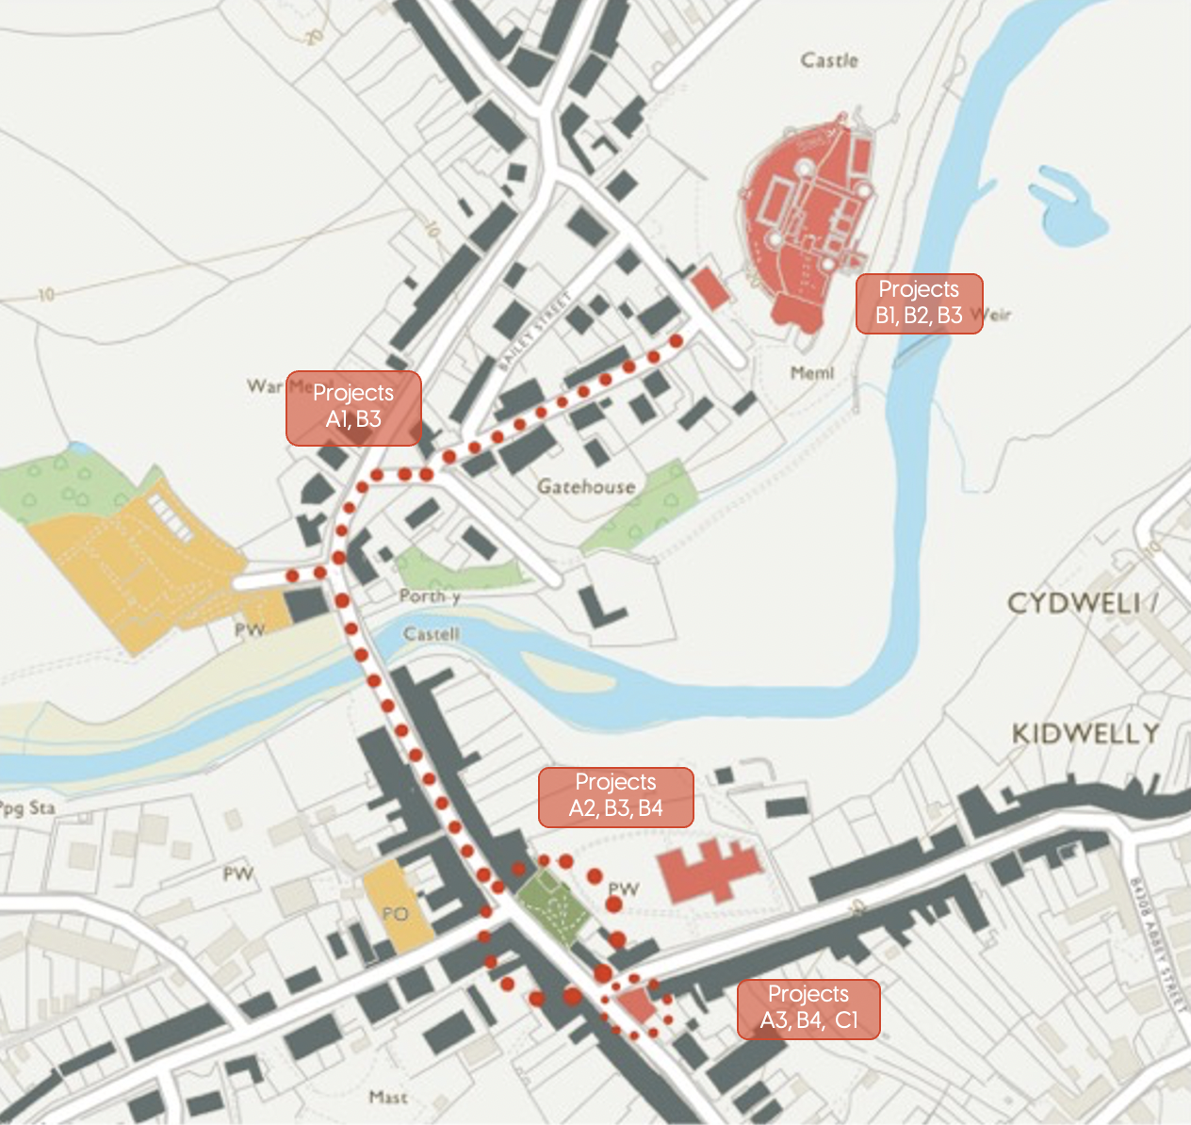
SUSTAINABLE ECONOMIC GROWTH PLAN
Figure 6 Priority projects

Slide 13
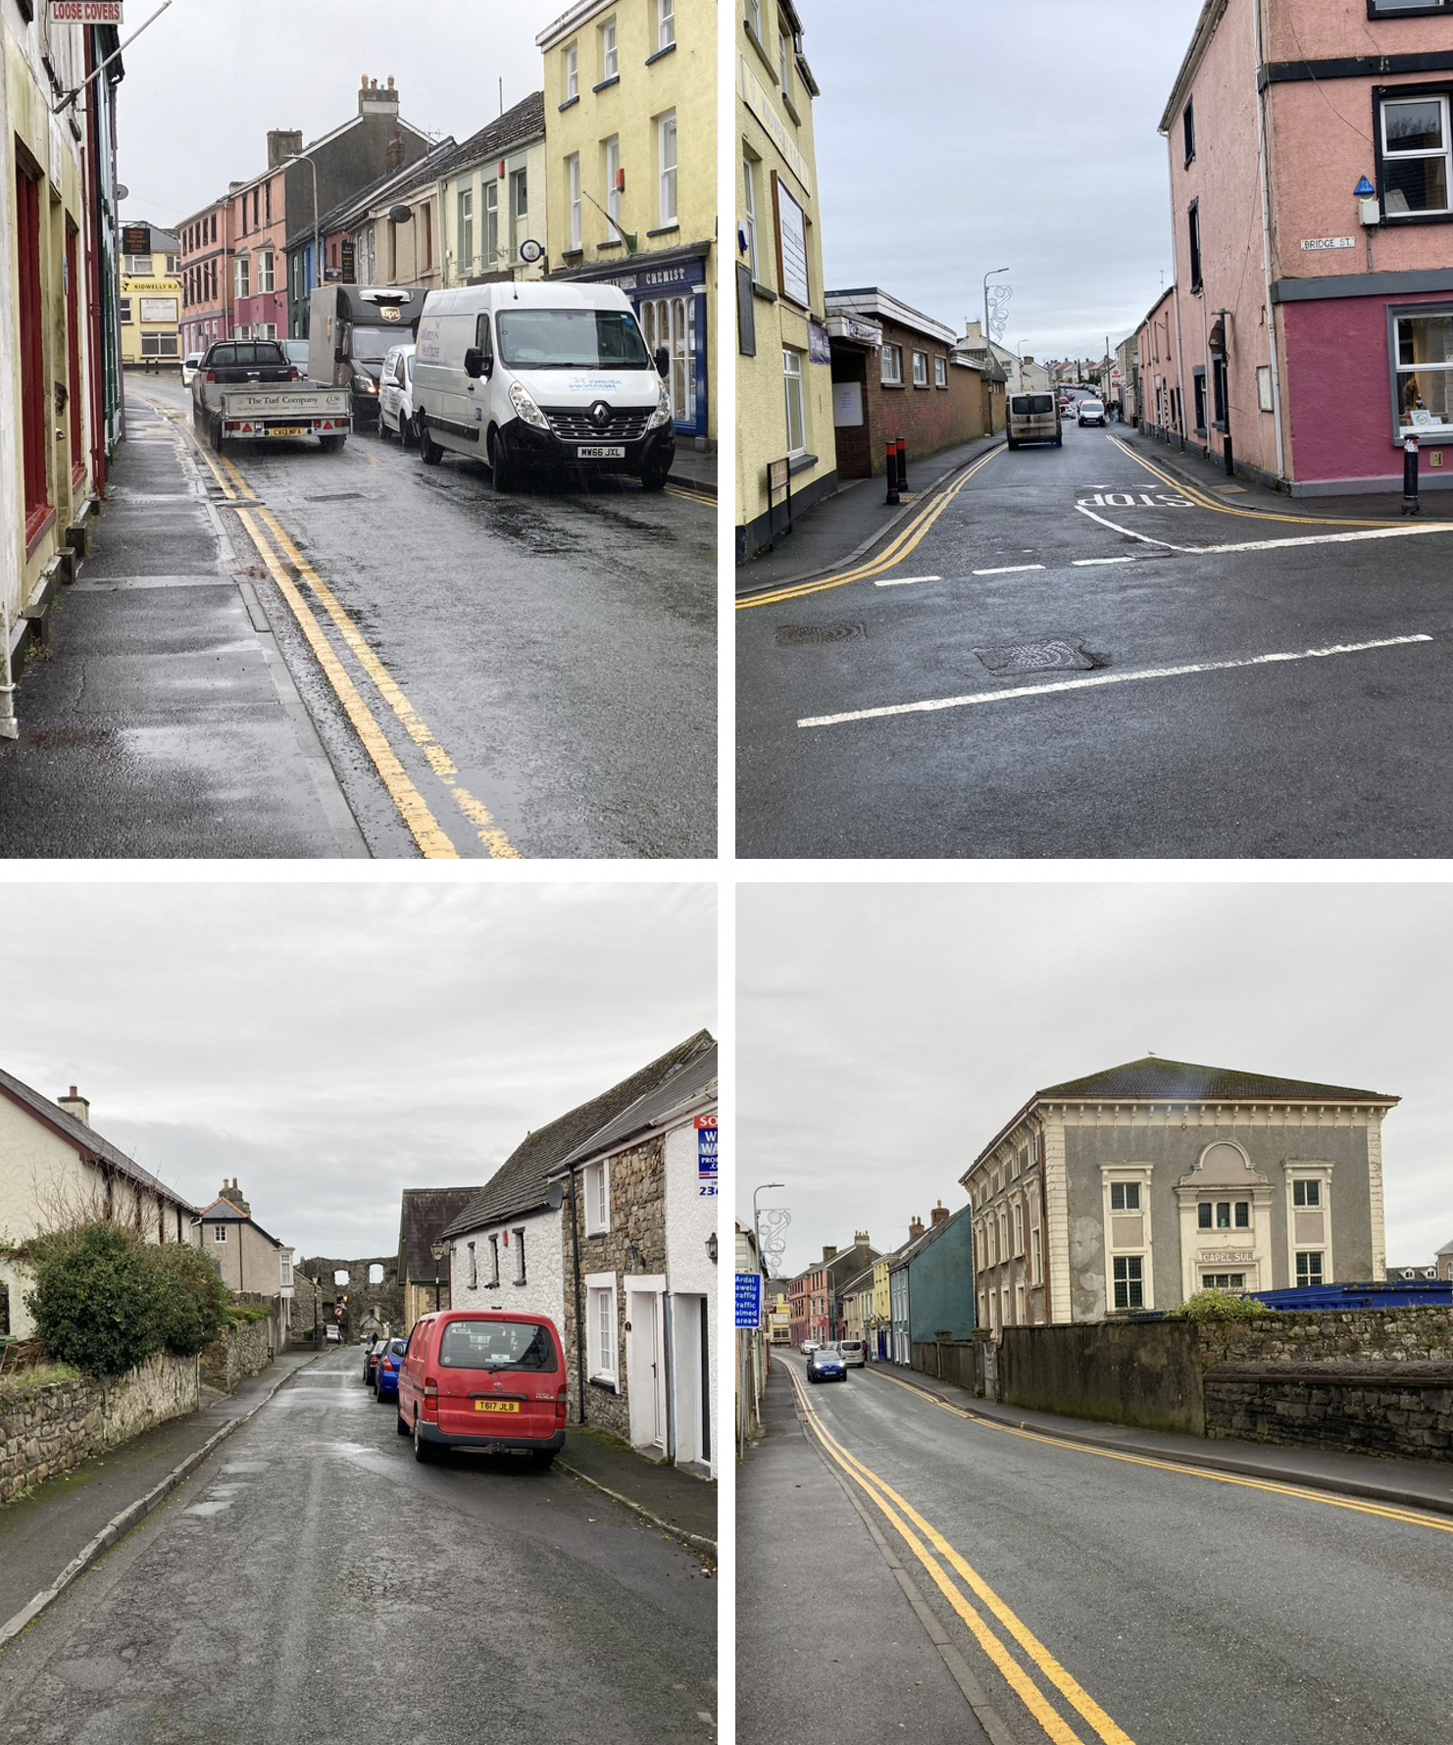
SUSTAINABLE ECONOMIC GROWTH PLAN
A) Create a more attractive and thriving town centre
A1) - Castle to Bridge Street environment
The redesign of the existing public space and street environment would help to create an attractive, inviting, integrated and safe connection between the Castle, the town centre and beyond. A design study should explore options to widen pavements and create shared spaces, improve crossing points, enhance legibility, manage the flow of traffic, and improve the overall appearance.
This would enhance the setting of the businesses and attractions located along Bridge Street to improve walking and cycling links and circulation that encourage visitor movement through the town centre.
It would also ensure the town centre functions more effectively as a whole and support the Wales Coast Path and National Cycle Route that passes along this route.
Improvements would help counter the long-term decline in the range and quality of town centre shops and services as well as encourage existing businesses to invest and create opportunities for new businesses to open. Grant support for businesses to invest in their own premises (particularly shop fronts and front elevations) in line with the public realm improvements should also be considered.

Slide 14
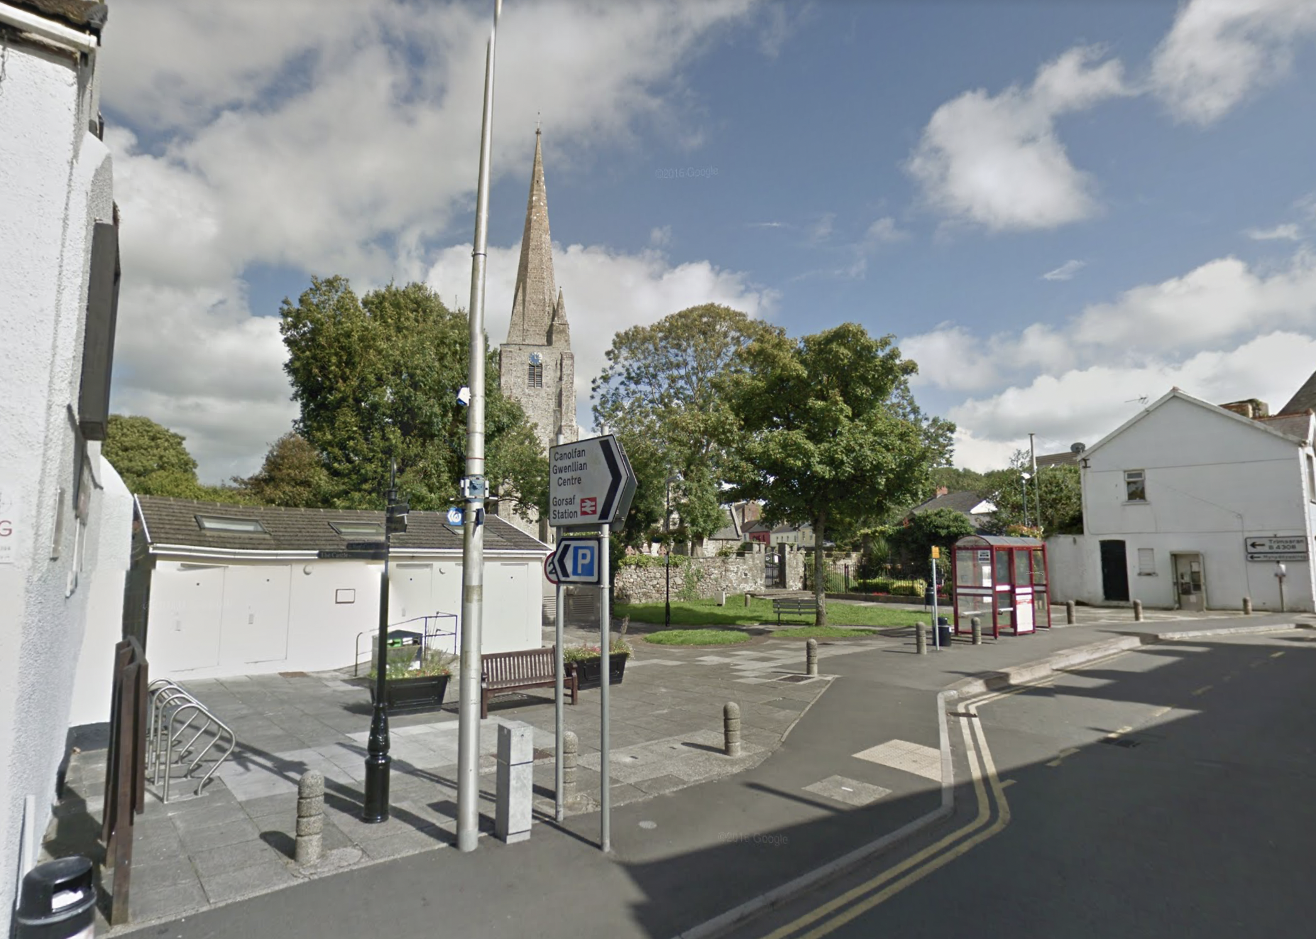
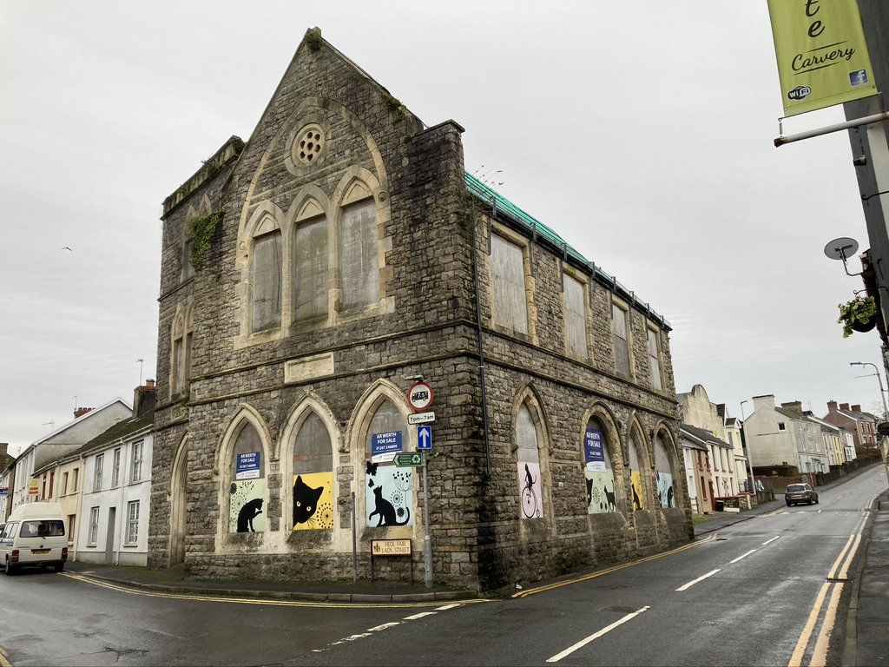
SUSTAINABLE ECONOMIC GROWTH PLAN
A2) – The Square
Prepare options for the re-design of the existing public space to create a significantly enhanced ‘market square’. This reimagined space should function as a focus for the town’s civic activities, informal leisure, business uses and improved location for the growing outdoor market.
However, the space is hindered by its layout and other features including the extent of road carriageway space. Improvements include decluttering the space, relocating the bus stop, and repositioning street furniture to open up the existing space.
Through reviewing this space, the feasibility of a temporary closure of the road to through traffic on market days should also be explored. Previous studies (Mackley Davies 2004) provide a useful starting point for the reimagining the Square but need to be reconsidered in light of the current requirements of improving this space and opening up pedestrian circulation as well as creating space for the market stalls.
A3) – Former Town Hall
The former town hall has stood empty for several years and is a highly prominent historic listed building that influences the setting and perception of the town centre. Owned by Carmarthenshire County Council, the property is for sale and several private investors have shown interest although the cost of restoring the listed building is likely to be a barrier to its redevelopment.
The building is ideally placed to be used to create an additional destination and increase footfall in the town centre through imaginative reuse of an impressive and historic landmark building. The role of the local authority will be key to help kick-start improvements either through light touch adaptive reuse, or more substantial redevelopment.
An options appraisal study to explore the reuse should be undertaken and could consider a range of levels of intervention including commercial use; employment workspace; creative attractions such as indoor adventure play, climbing walls etc.; tourist information, community and events space.

Slide 15
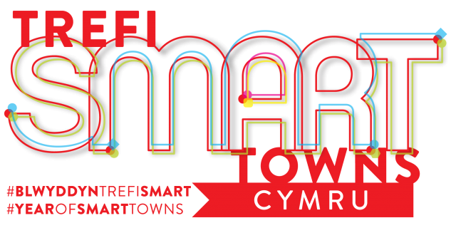
SUSTAINABLE ECONOMIC GROWTH PLAN
A4) – SMART Town
Kidwelly has an opportunity to become a SMART town that collects data through electronic methods and sensors to gain insights on how people use the town and to support its economic development. Many different types of data can be collected by a SMART town network, such as footfall and dwell time or the number of new visitors to the town and the origin of their journey.
The data collected through a smart town network is often provided to local businesses free of charge in a visual and accessible manner. Cardigan is an exemplar town with a smart town network up and running, where business owners regularly receive data collected (including footfall, dwell time and the number of new visitors to the town) as well as any key trends identified.
A smart town network would allow businesses, the Town Council, and local organisations to gain detailed insights on how people are using the town and what it means for their business. Using this data can inform staffing and hiring decisions, increase the impact of promotions as well as help to identify new markets and capture customer spend. This could provide a significant boost, potentially driving more footfall and spend as well as forming part of package that also attracts new businesses to set up in the town.
There are already proposals to prepare a digital action plan for Kidwelly through a SMART town imitative led by Carmarthenshire County Council’s Digital Connectivity Officer and the proposals set out in this plan should inform this work.

Slide 16
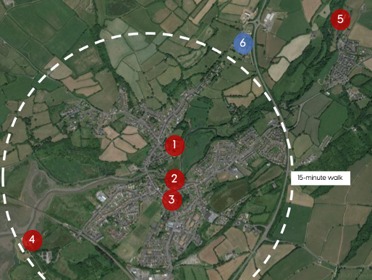
SUSTAINABLE ECONOMIC GROWTH PLAN
B) Growing Kidwelly’s profile and the attraction of the visitor economy
B1) 15-minute heritage
15-minute heritage is an initiative that promotes the idea of easily connecting the local history of an area to develop interconnected and accessible experiences of local historic buildings, monuments, and landscapes. The message is easy for visitors to understand and is currently being promoted by Cadw as a way of highlighting the importance and abundance of heritage close to town centres.
Kidwelly is well-suited to adopting the 15-minutre heritage approach to improve the visitor awareness and package the existing attractions within easy walking distance of the town centre
Figure 7 – 15-minute heritage in Kidwelly
Kidwelly Castle (1), St Mary’s Church (2), Town Hall (3), Kymer’s Canal and Quay (4). The potential of tying these assets together includes promoting those that are not often noticed by visitors such as the 19th century Slaughterhouse, canal and quay, and linking them with attractions further away at Parc y Bocs (6) and the Industrial Museum site (5).
The proposed Black Cat Trail (Coastal Communities Fund) is a series of commissioned cat statues placed around local landmarks and attractions and could provide a distinctive branded element for the 15-minute heritage initiative.

Slide 17
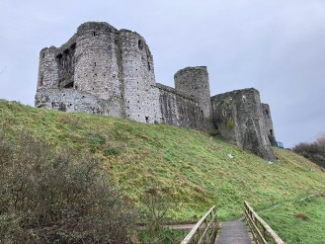
SUSTAINABLE ECONOMIC GROWTH PLAN
B2) - Kidwelly Castle
Kidwelly Castle is considered a match for the greatest castles of Wales and attracts some 30,000 visitors a year. It famously appears in the very first scene of ‘Monty Python and the Holy Grail’ and is the main heritage attraction in the Gwendraeth Valley.
Cadw are responsible for the castle and recognise the opportunities for Kidwelly Castle to become a stronger economic driver for the local economy in terms of visitor number and local spend.
There is a need for a mutually supportive strategy that ensures the town and Castle are working together to grow the level of visitors and to support longer duration trips to Kidwelly which take in more than one attraction as well as town centre facilities. Only through improving the overall Kidwelly experience, including the attractiveness and vitality of the town centre and wider attractions, will the number of visitors and their expenditure grow.
This Plan proposes a new model including the ideas for promoting 15-Minute Heritage with the Castle as the cornerstone. Such initiatives need Cadw, the Town Council, the Coastal Communities Fund initiative and local businesses to work as closely together as possible to improve the local visitor marketing, infrastructure and events.

Slide 18

SUSTAINABLE ECONOMIC GROWTH PLAN
B3) - Destination signage and Information
The town and its hinterland needs to improve the way in which visitors are informed, orient themselves and navigate from place to place in search of the hospitality and attractions. Improvements should be made to replace existing signage with a coherent, well sited, consistent high quality destination signage. This should include:
improved ‘brown’ visitor information signs promoting the full range of facilities and attractions located prominently at the principal gateways into the town along the A484 and also at Kidwelly Train Station
integration of the redeveloped ‘black cat’ brand (Coastal Communities Fund initiative)
walking distance/journey time markers to encourage walking and exploration – including 15-minute heritage
more prominent signage for the National Cycle Route 4 including the traffic free section of the route connecting the town centre with Carmarthen Bay Holiday Park
consistent use of bilingual and potentially overseas visitor signage
work with the proposed ‘Visit Kidwelly’ integrated website, dedicated to improving awareness of attractions around Kidwelly (Coastal Communities Fund)
Smart Town digital visitor information (see below)
Figure 8 Visitor symbols sign redesign

Slide 19
SUSTAINABLE ECONOMIC GROWTH PLAN
B4) – New visitor attractions
The Plan supports investment from business and stakeholder organisations that strengthen the diversity and quality of the town’s visitor attractions and extends the length of stay and potential for increased visitor spend. It includes the breadth of businesses located in the town centre, new activities and visitor attractions including potential reuse of the Town Hall, strengthening of the use of the town square, new accommodation, and emerging proposals for a new heritage attraction.
Small scale improvements to ‘animate’ existing attractions should be explored including for example opportunities for a local business to operate a seasonal ‘pop-up’ mobile coffee/tea outlet at the Kymer’s Canal and Quay. New attractions include the potential reopening of the Industrial Museum (subject to ongoing feasibility) and emerging proposals for a History Shed Experience. A feasibility study is already taking place exploring the possible renovation and extension of the full 5km length of Kymer’s Canal alongside a parallel study exploring a shared use cycle/footpath along the Gwendraeth Railway route (Kidwelly to Tumble).
The Valleys Regional Park includes the Gwendraeth Valley and whilst there are no direct plans for Kidwelly under this initiative opportunities to gain more prominence should be supported.
The Coastal Communities Fund support for new festivals and events including two / three key ideas should be supported and reflect the town brand identity.
The proposals are subject to individual feasibility assessments and development but collectively highlight the significant potential for further strengthening the critical mass and profile of Kidwelly as a heritage visitor destination.
B5) - SMART Tourism
The above-mentioned smart town network, particularly one that includes a town-wide Wi-Fi network, can be a massive asset for understanding in detail the nature of a town’s visitor economy, developing performance indicators for the Kidwelly visitor brand and to create a stronger and more economically sustainable visitor economy.
Through a town Wi-Fi network alone the number of visitors, visits, origin of visitors, dwell time and hotspots where people concentrate in a town can be identified. This alongside other valuable data can be collected and communicated to local businesses to help them develop and adjust their marketing campaigns, identify potential new markets and customers as well as improve their operational efficiency, through optimising staffing decisions for instance. The data collected helps build a detailed and up-to-date picture of how visitors use the town.
In Kidwelly this could inform an initiative within the digital action plan and connect the Castle with the Town Centre. Understanding the number and proportion of visitors that visit the town centre out of the total number of visitors to the town itself helps to develop an understanding of the scale of the opportunity there is to capture additional spend. Collecting this data also provides a baseline from which smart targets can be set by key stakeholders such as Carmarthenshire County Council, Cadw and the Town Council, for instance.

Slide 20
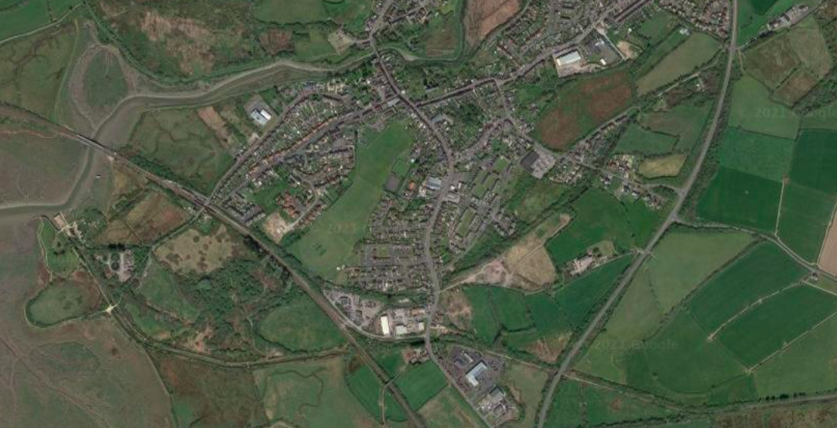
SUSTAINABLE ECONOMIC GROWTH PLAN
These could include increasing the average visitor dwell time by 30 minutes or increasing the number of visitors that walk from the castle to the town centre by 50%. SMART tourism enables these opportunities to be identified and targets to be set and ultimately evaluated.
Beyond providing valuable insights on the town centre, smart town networks, can directly enhance the visitor experience of the town. An exemplar from Cardigan is to provide the option to sign up to a newsletter when joining the town Wi-Fi network, which has visitors actively engaging with the town and provides the town and promotes upcoming events and business promotions. In addition, a location-based push notification can be installed, as in Cardigan, which triggers a notification on a visitor’s phone when they are near a specific location to encourage them to visit a particular location, such as St Mary’s Church or a shop in the town centre.
B6) - Electric Vehicle Charging
Growing the attraction of the Kidwelly economy, especially through attracting new visitors, includes the need for new supporting infrastructure. Electric vehicle (EV) charging points are already at the Princess Gwenllian Centre and Gravells however, positioning EV charging points in the main town centre car parks, should support the growth in town centre visits by those who need to spend more time in the town. Improvements would also support the uptake of electric vehicles within the local community, supporting a low carbon economy.
Figure 9 Map of EV charging points in the area
Potential location for a new charging station

Slide 21
SUSTAINABLE ECONOMIC GROWTH PLAN
C) Create opportunities for new business growth and expansion
C1) Business workspaces
Several options exist to address the shortage and types of available workspaces and create opportunities to encourage new enterprises and business growth in the Kidwelly area. These include the reuse of surplus and vacant town centre buildings, creating spaces within existing public and community buildings and new build. In rural areas the public sector also has an important role to play working with a range of smaller local developers and landowners to address the hurdles to development.
These include addressing the viability gap between the cost of building and modernising new employment spaces and the rental income; and an important economic development role in guiding small developers through the planning process.
Option for creating new employment and workspaces include:
Reuse of surplus publicly owned buildings such as the Town Hall and redundant school buildings
Working with owners to support adapting vacant commercial buildings e.g. vacant premises along Banc Pendre
Working with community organisations such as The Princess Gwenllian Centre and Kidwelly Community Hub to create office/shared workspace options using existing meeting spaces
Supporting the viability of creating new employment/business space through new site development and mixed use re-development of existing sites, including underutilised sites on Banc Pendre and Pembrey Airport.

Slide 22
SUSTAINABLE ECONOMIC GROWTH PLAN
C2) - Welsh speaking economy in Kidwelly
With 43% of the population able to speak Welsh in Kidwelly it remains an important aspect of the local economy and there is an opportunity to support the growth of local businesses, through the language. Menter Iaith have been assessing the support and use of Welsh in the area and working with local organisations to help grow the language at a grassroots level.
Helo Blod are a Welsh Government agency with the aims of increasing the use of Welsh in business in the area and provide individual support services for businesses through the local Helo Blod Officer.
In Kidwelly, supporting the use of the Welsh language through business and the economy has the potential to reinforce the town’s distinctiveness and to showcase its local identity and heritage. These combine to make a more appealing experience for visitors as well as supporting growth of local Welsh speaking business and the retention of local customers.

Slide 23
SUSTAINABLE ECONOMIC GROWTH PLAN
7 – Funding & delivery
Funding
Kidwelly has recently been awarded Coastal Communities Funding in support of the marketing and promotion of the town and in response to COVID-19, the County Council has established underpinning resources to support the recovery and growth of rural towns. Working with Welsh Government and the RDP Leader programme, a range of new initiatives and business support will be made available.
The sustainable economic growth plan form an important basis for identifying local needs and the range of opportunities these new funds and resources could help to deliver, which include:
The new Market Town Officers who will work with the town to take forward actions identified within the economic recovery and growth plans.
New seed funding to assist the town's growth plan teams to develop innovative solutions to meet both their immediate needs and future growth ambitions.
Potential for new capital funding to support ideas identified in the recovery and growth plans and also to support the development of much-needed start-up and grow on employment space.
Carmarthenshire County Council Business Grant Funds – opportunities for businesses to apply for direct support through the Rural Enterprise Fund, Transformational Commercial Property Development Fund, Business Start-Up Fund and Business Growth Fund.
Town digital solutions – a series of initiatives to support businesses and communities to obtain faster and more reliable internet connectivity and application of digital SMART towns.

Slide 24
SUSTAINABLE ECONOMIC GROWTH PLAN
Funding has been secured for local marketing/distinctiveness including branded promotional material, prepared social media content for every town.
Local energy plans - Carmarthenshire Energy Limited will support communities to identify and scope potential sites for new energy generation.
Circular Economy - support with initiatives that grow manufacturers design products to be reusable and the reuse of materials.
Delivery
The growth plan is for all the stakeholders of Kidwelly and requires commitment and effort from local authorities, community organisations and businesses for the town is to be successful and deliver sustained prosperity. This plan is necessary to provide a clear pathway for the prioritised actions over three levels of importance:
Immediate - actioning of quick-win permanent or temporary schemes, to take advantage of available seed funding and current programmes.
Short term - delivery within the next 2-3 years - priority transformational projects that may require feasibility studies, planning, funding, approvals before delivery.
Strategic - Significant projects and strategies that may take several years to develop and will help guide the towns direction to be resilient and to respond to long term changes.

Slide 25
SUSTAINABLE ECONOMIC GROWTH PLAN
Action | Key delivery partners | Resources | Next steps | Timeframe
 |  |  |  | Immediate | Short | Strategic
A) Create a more attractive and thriving town centre
A1) - Castle to Bridge Street environment | Carmarthenshire CC | Ten Towns Seed Fund and Capital Fund | Prepare design brief for redesign and strategies for increasing useable pedestrian space, outside use of space by businesses. Matching support for enhancement of commercial property/town centre living
A2) – The Square | Carmarthenshire CC Kidwelly Town Council St Mary’s Church | Ten Towns Seed Fund and Capital Fund | Prepare design brief for redesign and strategies for increasing useable pedestrian, markets, event, and activity space. Option for joint commission with Bridge Street study.
A3) – Former Town Hall | Carmarthenshire CC | Ten Towns Seed Fund and Capital Fund | Options appraisal study to explore reuse and strategies for a range of interventions including commercial, workspace, community, leisure.
A4) – SMART Town | Carmarthenshire CC Kidwelly Town Council Businesses Cadw Coastal Communities Initiative | Carmarthenshire SMART/digital program | Undertake a SMART town audit and prepare action plan
B) Growing Kidwelly’s profile and the attraction of the visitor economy
B1) 15-minute heritage | CADW Kidwelly Town Council Coastal Communities Initiative | Carmarthenshire CC capital funds & Coastal Communities Fund | Review proposals as part of the implementation of the Coastal Communities initiatives and Black Cat Trail.
B2) - Kidwelly Castle | CADW Kidwelly Town Council Coastal Communities Initiative |  | Memorandum of understanding to agree on mutually supporting strategies and joint working
B3) - Destination signage and Information | Coastal Communities Initiative Carmarthenshire CC Kidwelly Town Council | Carmarthenshire CC capital funds & Coastal Communities Fund | Strategic review of signage and information with strategy for new, replacement and renewed signage. Strengthen and extend routes between town and wider hinterland
B4) – New visitor attractions | Carmarthenshire CC Kidwelly Town Council Coastal Communities Initiative Industrial museum Private sector | Project specific including public and private finance | Several opportunities with potential to support including Kymer Canal Feasibility – review of findings; Industrial Museum; events and festivals
B5) - SMART Tourism | Carmarthenshire CC Kidwelly Town Council Businesses Cadw Coastal Communities Initiative | Carmarthenshire SMART/digital program | SMART town audit and preparation of an action plan
B6) - Electric Vehicle Charging | Carmarthenshire CC Kidwelly Town Council Business | Welsh Government’s Local Transport Fund & Government Low Emission Vehicle grant schemes | Option appraise the location of charging points at Glan-yr-Afon and Station Road car parks
C) Create opportunities for new business growth and expansion
C1) Business workspaces | Carmarthenshire CC Business & property owners | Carmarthenshire CC capital funds/private sector | Local promotion of available grant schemes and targeting at key property e.g. Town Hall
C2) - Welsh speaking economy in Kidwelly | Helo Blod Businesses | Helo Blod | Helo Blod local advisor to support businesses with bilingual visibility through marketing, customer development etc

Slide 26
OWEN DAVIES CONSULTING LTD
7A NEVILL STREET ABERGAVENNY,
NP7 5AA

