Slide 1

Energy
Understanding different energy sources, renewable vs non-renewable and the different impacts on the planet.
While also understanding how to be energy efficient in school/home and how to take action.

Slide 2


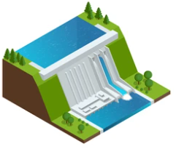

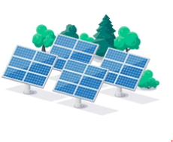
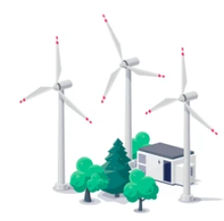
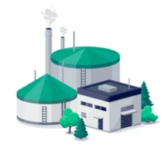
What are all the different types of energy sources?
Notes:
Food, oil, coal, gas, petrol, turf and wood.
Waves, tides, wind, falling water, light, geothermal, nuclear.

Slide 3
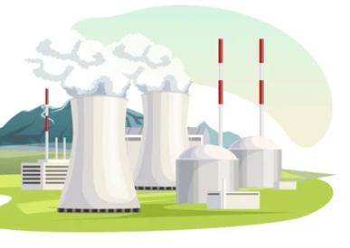
Non-Renewable Energy
From Fossil Fuels
How are they formed?
Why do we need to stop using them?
What are the different types?
https://www.bbc.co.uk/bitesize/topics/z6wwxnb/articles/ztxwqty
Notes:
Answers in the video provided: https://www.bbc.co.uk/bitesize/topics/z6wwxnb/articles/ztxwqty - Suggestion: Mind map on the whiteboard before watching the video
- Coal, Gas and oil – Fossil fuels
- Develop over millions of years making them a non-renewable fuel source. Unsustainable as they are depleting rapidly.
- Release greenhouse gases into the atmosphere causing the greenhouse effect.

Slide 4
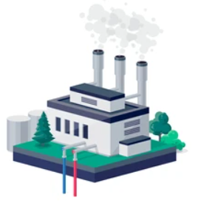
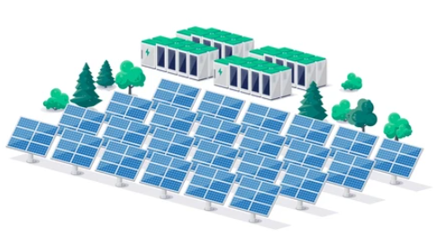
Renewable energy
What are the different types?
Does the UK use renewable energy?
Why do we need to use them?
Renewable Energy 101 - YouTube
Notes:
Answers in this video Renewable Energy 101 - YouTube- Suggestion: Mind map on the whiteboard before watching the video
They can be replenished within a human's lifetime, meaning they won’t run out whereas, Non-Renewable energy (Fossil Fuels) does.
Solar, Wind, Hydropower, Biomass, Tidal, Geothermal.
Clean source of energy, does not directly produce greenhouse emissions.

Slide 5
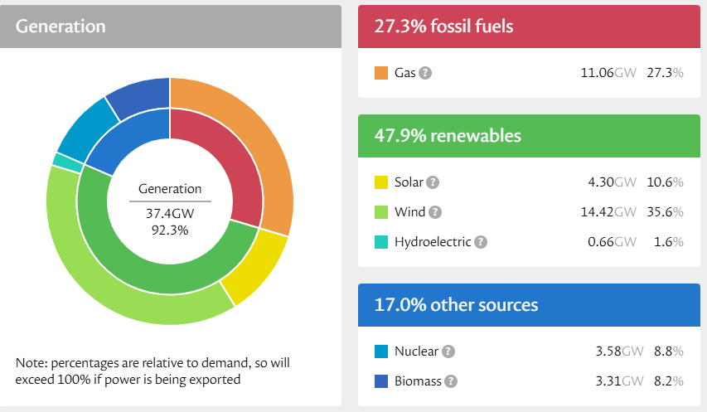

UK Energy Mix
In recent years, the UK have made a fundamental shift from most of our energy coming from fossil fuels. We now get most of our energy from renewables which is great news for the planet.
Nuclear is considered as “other” due to the toxic waste produced & the need for fossil fuels.
Biomass is considered as “other” as it emits greenhouse gases & air pollutants
https://grid.iamkate.com/
Data taken on: 17/11/2025

Slide 6

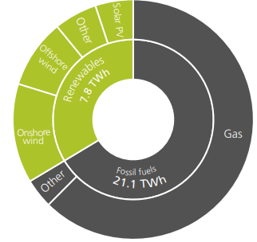
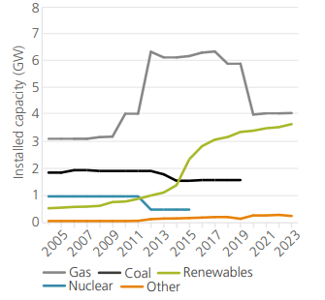

Wales Energy Mix
Electricity Generation in Wales (2023)
66% Fossil Fuels 15.4 TWh
Gas Other
Fossil Fuels still account for the largest proportion of energy generation in Wales
34% Renewables 7.8 TWh
Solar PV Offshore wind Onshore Wind Other
However, renewable generation is increasing year on year
There was 3663 MW of renewable electricity capacity in 2023
Source: Energy Use in Wales 2023
Did you know?
In 2023 Carmarthenshire was the third highest renewable energy generator in Wales. Accounting for 8% of Wales’s total renewable energy output.
Notes:
The latest report on Wales’s energy mix uses data from 2023.
Wales has a climate target for 70% of its electricity demand to come from Welsh renewable energy sources by 2030, by looking at this data do you think this is achievable?

Slide 7
Why do we need to use renewable energy?
Greenhouse gases heat the atmosphere
Burning fossil fuels to provide electricity/heat produces greenhouse gases
This heat, increases global temperature. Increasing the effects of climate change
However, renewable energy does not produce greenhouse gases
And is sustainable, so it can constantly be harnessed
As renewable energy sources will never run out
Wales has the potential to have energy security through renewable energy

Slide 8
True or False?
The Sun produces light energy which travels to Earth
Solar panels are not able to store energy
Solar panels can be located inside homes and on roofs
Solar panels are not able to move once they are installed
Solar
The temperature does not change the amount of energy generated by a solar panel; it is only the strength of sunlight that makes a difference.
The sunlight is captured using large panels which are made up of solar cells
Solar panels only generate electricity at night
How does solar energy work? - BBC Bitesize
Notes:
True: The Sun has light energy which travels to Earth
True: The temperature does not change the amount of energy generated by a solar panel; it is only the strength of sunlight that makes a difference
True: The sunlight is captured using large panels which are made up of solar cells
True: Solar panels are not able to store energy
False: Solar panels can be located inside homes and on roofs - Located on the outside of roofs/ fields/ other external structures
False: Solar panels only generate electricity at night – Solar panels only generate electricity in the day
False: Solar panels are not able to move once they are installed – Solar panels can move, so they are always directly facing the sun.

Slide 9
Wind
True or False?
As the wind blows, it transfers some of its kinetic energy to the blades, which turn and drive the generator.
Wind energy can only be harnessed during the day
The amount of electricity generated depends on the strength of the wind
They can be located in the sea and on land.
Wind turbines move all day everyday
Several wind turbines may be grouped together to form a wind farm.
How does wind energy work? - BBC Bitesize
Notes:
True: As the wind blows, it transfers some of its kinetic energy to the blades, which turn and drive the generator.
True: The amount of electricity generated depends on the strength of the wind
True: Several wind turbines may be grouped together to form a wind farm.
True: They can be located in the sea and on land.
False: Wind energy can only be harnessed during the day - wind energy can be harnessed as long as the wind is blowing
False: Wind turbines move all day everyday – They only move when the wind is blowing

Slide 10
Hydroelectricity
True or False?
Scotland generates 85% of the UK’s hydroelectric power.
The moving water is used to generate electricity
It is an unreliable energy source.
The water moves from a low point up to a high point
The energy is generated through potential energy into kinetic energy – through the movement of the water
Does not produce greenhouse gases, so does not contribute to climate change
How does hydroelectric energy work - BBC Bitesize
Notes:
True: Scotland generates 85% of the UK’s hydroelectric power
True: The energy is generated through potential energy into kinetic energy – through the movement of the water
True: Does not produce greenhouse gases, so does not contribute to climate change
True: The moving water is used to generate electricity
False: It is an unreliable energy source - It is a reliable energy source. Unlike wind and the sun, we know that stored water can provide a 24/7 source of kinetic energy.
False: The water moves from a low point up to a high point - The water moves from a high point to a low point to generate energy

Slide 11

Advantages & Disadvantages of Renewable Energy
You can use the energy created, to reduce electricity bills.
Energy can only be harnessed during the day
There is an upfront cost to install them.
No harmful gases are produced once in use, so it is environmentally friendly.
The concrete used, is a high intensity process which creates a lot of greenhouse gases
Initial cost is expensive
You can store the energy to use when the sun isn’t shining.
It is a renewable energy source
The energy can be accessed quickly to produce energy at peak times.
Energy cannot be stored with this renewable source; a battery is required which can be expensive
The amount of electricity generated depends on the strength of the source
They are noisy and may spoil the view for people living near them.
Energy from this natural source is free and the running cost of the machine is relatively low.
Destroys habitats and local environment within the construction
Notes:
Get the learners to fill out task 1: Advantages & Disadvantages Worksheet - correctly match each advantage & disadvantage for the renewable energy sources.
There is an answer sheet in the resource section for this lesson.
https://www.bbc.co.uk/bitesize/guides/zd4bcj6/revision/3

Slide 12
What is Energy Efficiency?
What is energy efficiency? - YouTube
Notes:
Separate video on energy efficiency which could be beneficial to KS4 - https://www.youtube.com/watch?v=D11iFUw_ImU

Slide 13


Different ways to be energy efficient
Energy, let's save it! - YouTube
Notes:
Get the learners to watch the video and spot the different ways the school can be more energy efficient. Stop the video at 3:15 minutes.
Suggested answers:
- Closing windows
- Turning off taps when not in use
- Turning lights off when not in use
- Making sure the school has LED lights instead of ordinary bulbs
- Keep the temperature of the room around 18-20 degrees
- Making sure radiators aren’t covered
- Switch off appliances not in use
- Walk, Cycle, Scooter, Bus, Train to school instead of using private car.

Slide 14

How can your school be energy efficient?
By completing an energy assessment.
Pick out key actions that your class can do.
Stick to them !
Inspire other classes to take up these actions

Slide 15
ACTIONS !
Action 1:
Action 2:
Action 3:
Notes:
What energy efficiency actions are you as a class going to take?

Slide 16


Summary
Fossil Fuels
A natural fuel such as coal, gas and natural oil. It is used to power engines/provide heat/electricity.
This energy source is not renewable which means once it's used up, it’s gone.
Atmosphere
A layer of gas that surrounds the earth, which is made up of many different gases including oxygen.
Greenhouse gases
Gases in the Earth’s atmosphere that trap heat.
Renewable
Fuel collected from sources which won’t run out or will be replaced by nature in less than a human's lifetime

