Slide 1
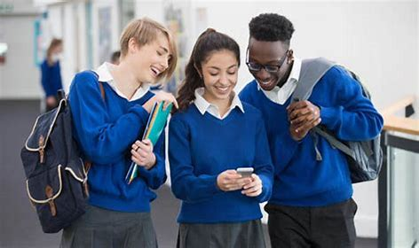
Title: Why should I be cautious when watching influencers online?

Slide 2
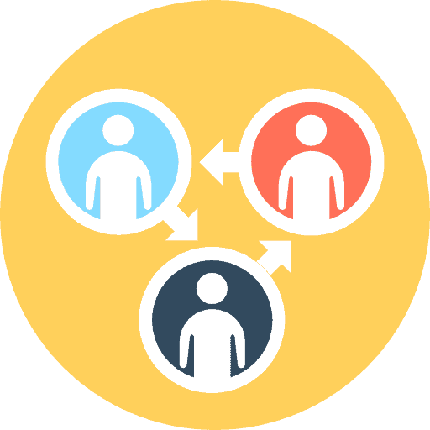
A reminder: the ground rules
Listen to others - Please do not talk over each other. It is okay to disagree, but we should not make assumptions and when we disagree, challenge the statement not the person
Respect and privacy - Use respectful language and body language. Discuss examples but do not use people’s names or identify anyone inside or outside of the classroom
No judgement - We can explore beliefs and misunderstandings about a topic without fear of being judged
Level of participation – No body will be put ‘on the spot’. Everyone has the right to choose not to answer a question or join a discussion
Seeking help - Anyone who feels they would like to talk to someone further about a particular topic can go see their form tutor, teachers, Head of Learning or speak to Mrs Lisa Jones

Slide 3
Getting started!
For the first 7 minutes, you are going to complete four quick tasks! Ready?

Slide 4
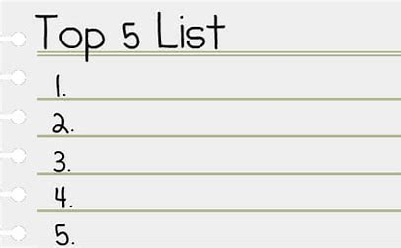
Task one: Who do you follow online?
Create a list of your top 5 favourite online influencers.
You have one minute! GO!

Slide 5
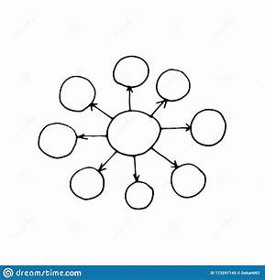
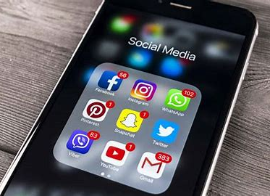

Task two: On your worksheet, create your own spider diagram with at least five words to describe an online influencer. You have two minutes! GO!
Time to feedback!
What words have you written down?
Going around the class, choose one of your words to share
GO!

Slide 6

Task three: Are your words positive or negative?
Create a tally for them all.
Positive
Negative

Slide 7

Task four: Reflection
Using the knowledge from our class feedback and your own views, to answer this question on your worksheet:
Do you want to be an online influencer after school? Why?
You have three minutes.

Slide 8

Well done!
Put your pens down for the next section and be ready to discuss and listen.

Slide 9
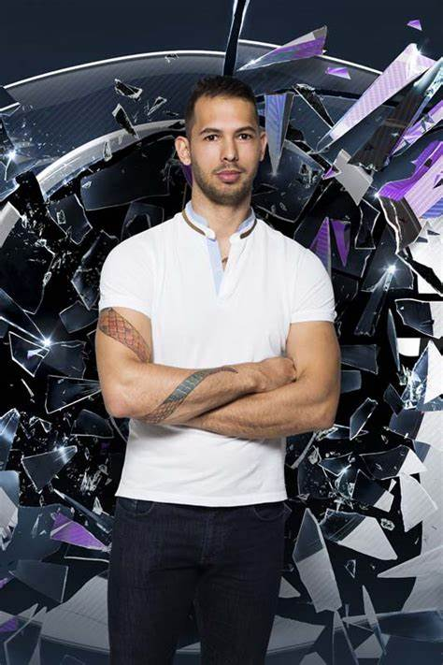
Do you follow this online influencer?
His name is Andrew Tate.
Task five: Tell your partner all that you know about this man?
Be ready to feedback to the class!
You have one minute! GO!

Slide 10
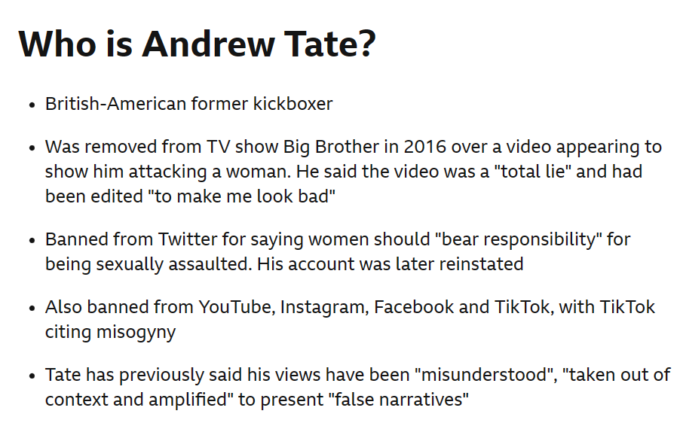
Do you follow this online influencer?

Slide 11
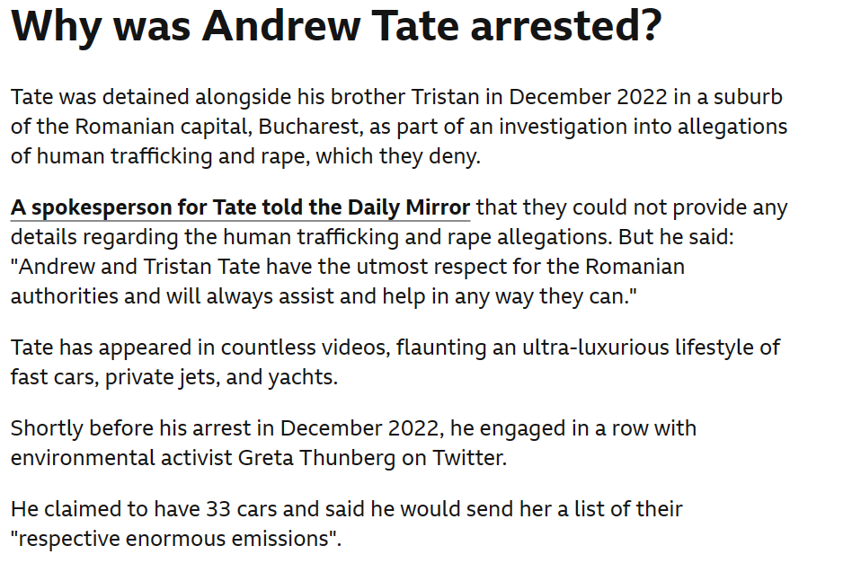
Do you follow this online influencer?

Slide 12
We are now going to watch a video, followed by a podcast that talks about Andrew Tate’s impact.

Slide 13
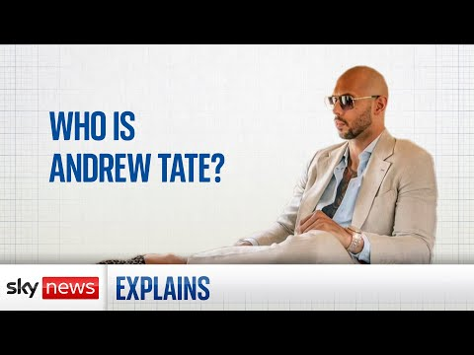
What is he famous for?
What else do we know about him?
Why is he considered divisive (some one who causes disagreements between people)?
Why do people listen to him?
What job did Tate have before he became an influencer?
Why was Tate removed from the ‘Big Brother’ house?
How has Tate described himself?
Which social media platform was Tate banned from, and then controversial reinstated to?

Slide 14
There are many key words surrounding this issue, some we have heard already...can you name any?

Slide 15
Task five: Key words
Here are the key words you need to be informed about on this issue.
Can you match them up to their definition? You have 5 minutes!
influencer
dislike of, contempt for, or ingrained prejudice against women.
misogyny
harmful beliefs about the way men should behave.
misogynistic
a person or thing that impacts another.
strongly prejudiced against women.
toxic masculinity
the process of making someone more extreme in their opinions on an issue.
echo chambers
when a person meets only beliefs or opinions that are the same as their own, so that their views are reinforced, and alternative views are not considered and spread.
algorithm
radicalisation
a set of mathematical instructions that if given to a computer, will help to calculate probability of what you wish to watch.

Slide 16
Key words reveal!
Influencer - a person or thing that impacts another.
misogyny - dislike of, contempt for, or ingrained prejudice against women.
misogynistic - strongly prejudiced against women
toxic masculinity - harmful beliefs about the way men should behave
echo chambers – when a person meets only beliefs or opinions that are the same as their own, so that their existing views are reinforced, and alternative views are not considered and shared
algorithm - a set of mathematical instructions that, especially if given to a computer, will help to calculate probability of what you wish to watch.
radicalisation - the action of making somebody more extreme or radical in their opinions on an issue.

Slide 17


Now for the podcast.
You will hear BBC 5 Live Breakfast presenter Rachel Burden speak with Michael Conroy and Helen Hinde.
Michael is the founder and director of Men at Work - a charity that trains professionals who work with boys and young men to help positive discussions about being safe around women and girls.
Helen is the Assistant Head at Meols Cop high school in Southport.

Slide 18
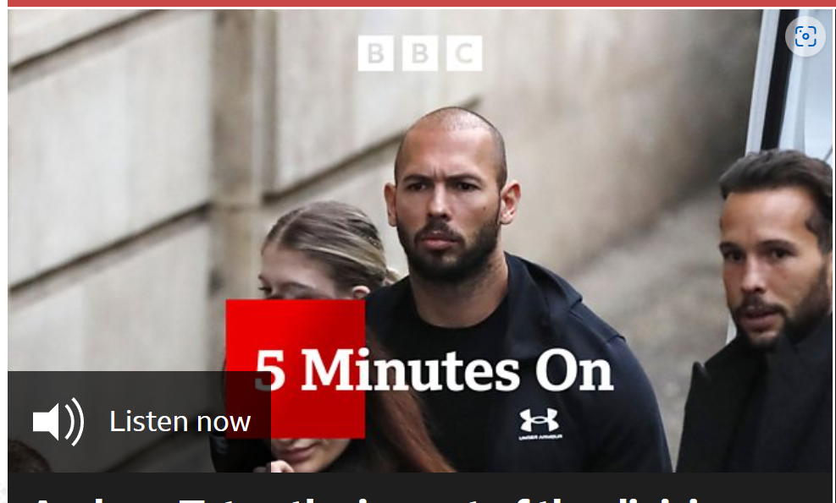
BBC News - 5 Minutes On, Andrew Tate - the impact of the divisive influencer

Slide 19
Task six: Discussion
Do you think Andrew Tate is harmless? Why?
What happens when we take in his messages?
What can be the further consequences of these views?
What would your reaction be if a women in your family was treated in this way?

Slide 20
Do we need be cautious when watching all influencers?

Slide 21
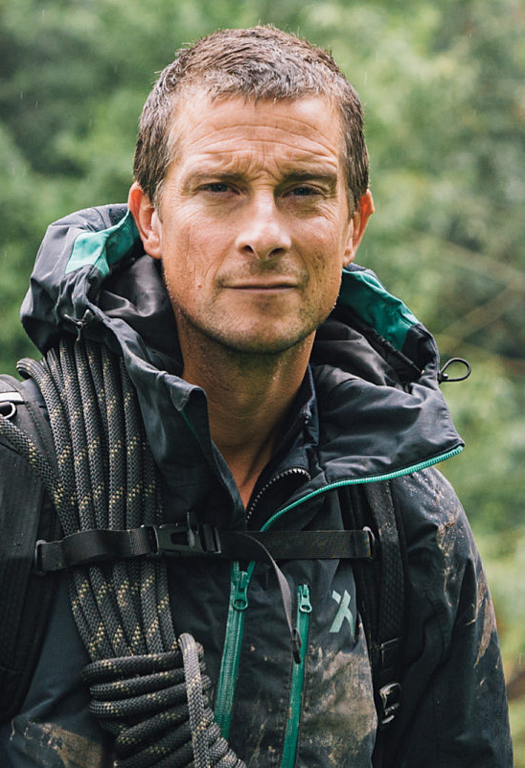
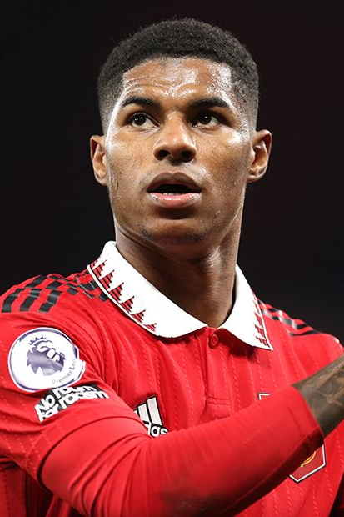
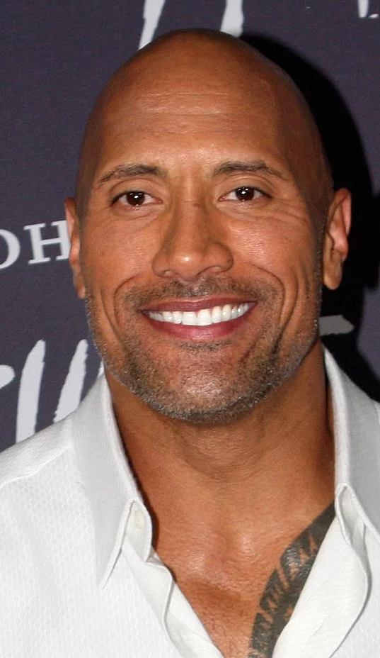
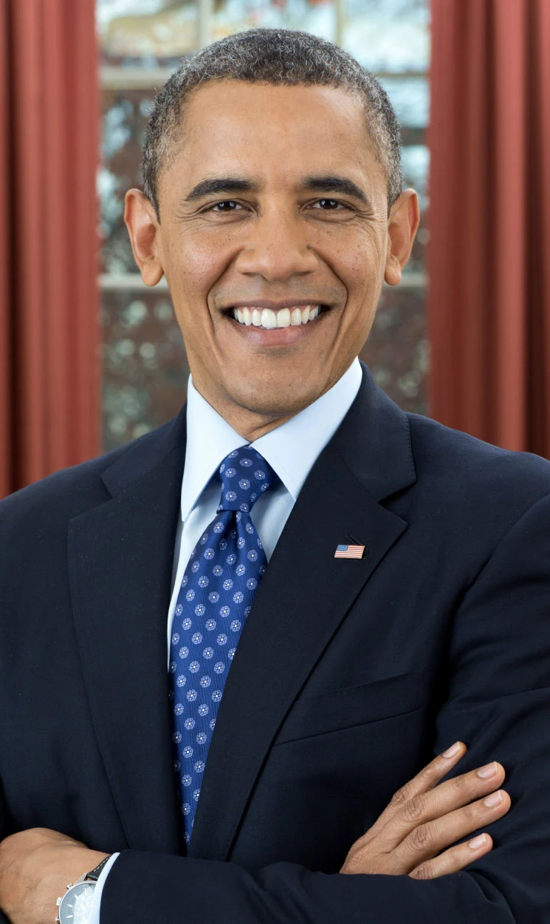
Who are good male role models? Why?

Slide 22
Discuss
Is Andrew Tate a good role model?

Slide 23
Plenary: Why should I be cautious when watching influencers online?

Slide 24

Task 7: Plenary
Create your own thought summary on this question.
You can present this however you wish
Try to use the key words in your summary
How can understanding this topic in more detail lead to our school being a more positive and enjoyable place to be for all?
Why should I be cautious when watching influencers online?

Slide 25
Key points:
Echo chambers can lead to what feels like validation, but this is only due to algorithms.
You must evaluate the credibility of these views.
There are positive and negative role models.
Attitudes inform society and then our experiences.
Choose to challenge it!

Slide 26
Finished?
What is the difference between toxic masculinity and misogyny?
Toxic masculinity
- harmful beliefs about the way men should behave
Misogyny
- strongly prejudiced against women
As a class sort the statements below:
Trying to control what your girlfriend wears
Ordering a man a beer without first asking what he wants
Presuming someone is more manly because they have a beard
Expecting women to “make you a sandwich”
Calling a man gay because he is drinking a cocktail
Laws that prohibit women from doing things, such as driving
Being disgusted by womens body hair but okay with mens
Thinking women are too emotional to be good leaders
A women behaving sexually makes her a “slut” but a man is fine
Telling someone to “man up”

Slide 27
Check your answers as a class.
Remember that when someone has harmful beliefs about the way men should behave, it can lead to strong prejudiced views against women.
Toxic masculinity
- harmful beliefs about the way men should behave
Misogyny
- strongly prejudiced against women
A women behaving sexually makes her a “slut” but a man is fine
Expecting women to “make you a sandwich”
Ordering a man a beer without first asking what he wants
Presuming someone is more manly because they have a beard
Being disgusted by womens body hair but okay with mens
Thinking women are too emotional to be good leaders
Calling a man gay because he is drinking a cocktail
Telling someone to “man up”
Laws that prohibit women from doing things, such as driving
Trying to control what your girlfriend wears

