Slide 1

Health and well-being
Sexting

Slide 2


Sexting
Objectives:
  To outline what sexting and grooming is.
  To discuss the consequences of engaging in sexting – socially and legally.
  To think of advice that could be given to other who feel pressured into engaging in sexting.

Slide 3



What does the term ‘sexting’ mean?
Can you give any examples of sexting?
What is ‘grooming’?
Can you give any examples?
Think
Pair
Share

Slide 4
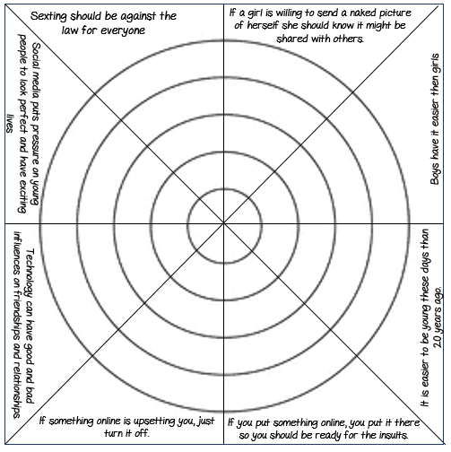
Starter: What is your opinion?
  Read each of the statements on the dartboard and decide to what extent you agree with it. The closer to the middle you are the more you agree.

Slide 5
What is Grooming?
What is sexting?
Sexting is when someone shares sexual, naked or semi-naked images or videos of themselves or others, or sends sexually explicit messages.
They can be sent using mobiles, tablets, smartphones, laptops - any device that allows you to share media and messages.
Grooming is when a person builds an emotional connection with a vulnerable person or child in order to gain their trust for the purposes of sexual abuse, exploitation, trafficking or radicalisation.
What does the law say about sexting?
It is illegal for a young person (under 18) to create an explicit photo or video of themselves or a friend, share an explicit image or video of a child, even if it’s shared between children of the same age; possess, download or store an explicit image or video of a child, even if the child gave their permission for it to be created.
If shared with a person over 18, the over 18 person are in possession of child pornography and therefore can face up to 2 years in prison.

Slide 6
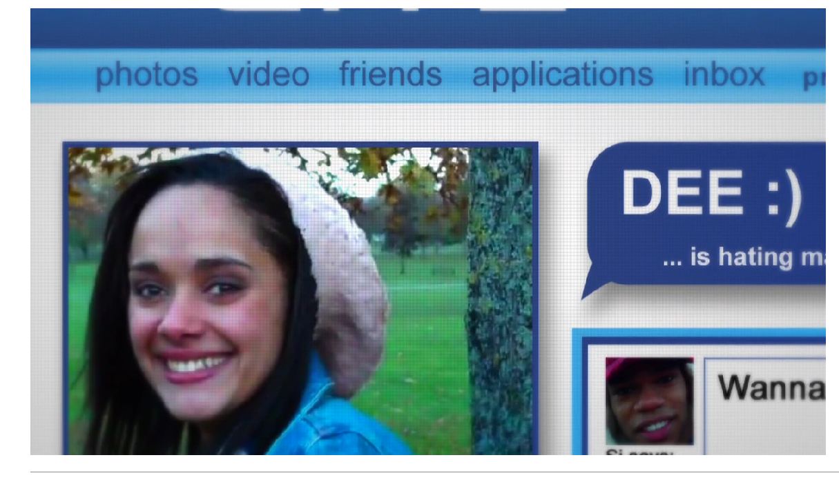

Sexting – Dee’s Story
CEOP – Exposed - Pukka Films
Notes:
CEOP - Exposed - YouTube

Slide 7
Sexting – Dee’s Story
TASK 1 - Write out questions and your answers.
  Why do you think that Dee sent the picture to Si in the first place? Why might others do the same?
  Who is most at fault in this situation – Dee, Si or Jay?
  Dee appears to be getting a lot of negative attention from these photos. Do you think that Si or Jay would get the same kind of attention if the photos were of them?
  What could be the long term and Short term consequences of this situation?
  What could Dee do to handle the situation?

Slide 8
Sexting – Dee’s Story
TASK 2:
  Dee has emailed to you to ask for advice on what she should do now that the pictures are out for everyone to see.
  Write an email back to her giving her advice on what she could do to lessen the consequences of the situation.

Slide 9
Sexting – Dee’s Story
TASK 2 :
  Dee has emailed to you to ask for advice on what she should do now that the pictures are out for everyone to see.
  Write an email back to her giving her advice on what she could do to lessen the consequences of the situation.
  Success criteria:
  MUST write an email in paragraphs giving at least ONE piece of suitable advice on what Dee should do.
  SHOULD give MORE THAN ONE piece of suitable advice and offer some empathy and understanding of Dee’s situation.
  COULD offer some hope that Dee’s situation will improve and she won’t always feel this way.

Slide 10
Starter sentences
Hi Dee,
I heard about what has happened and…
I am writing to say…
I understand…
I think that…
You should…
One idea would be…
In my opinion you should…
My advice is…
From …

Slide 11
Where can I go for help?
Speak to a teacher about it
Speak to someone at home or a friend
Tell your Head of Learning
Speak to Mrs Lisa Jones

Slide 12

Plenary
"Just send it" | Childnet
A film about the consequences of sexting.
Finish this sentence…
Learning about sexting has made
me think/ made me realise that…
You could upload a video of your answer
to Google Classroom.

