Slide 1

Health and well-being
Digital footprints

Slide 2

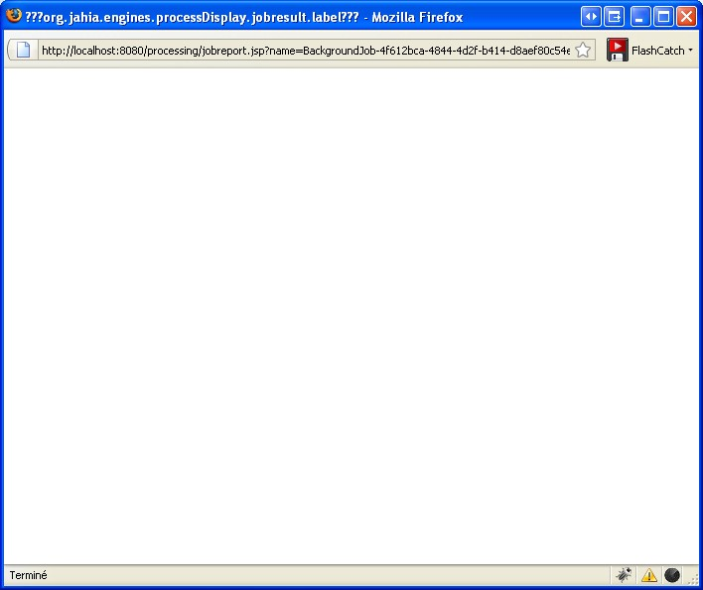
Consequences Of Online Behaviour
Objectives:
    To think about what your online reputation is and how it can impact the real world.
    To consider what the consequences are for inappropriate online behaviour.
Starter:
    For each of the tweets on the page note down what your first impression of each of the people that sent those tweets is.
Notes:
https://www.bbc.co.uk/teach/class-clips-video/pshe-computing-gcse-digital-footprint/zfygbdm

Slide 3
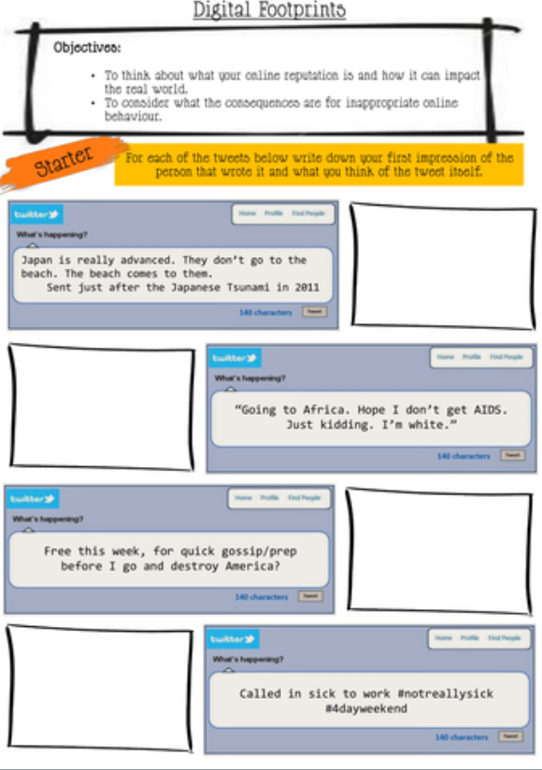
Notes:
https://www.youtube.com/watch?v=fBKJQCogSOM

Slide 4


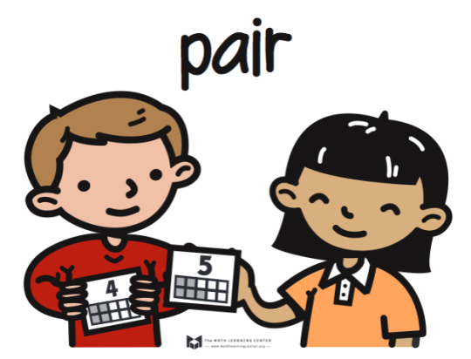

What does the term ‘digital footprint’ mean?
Can you give any examples?
Think
Pair
Share

Slide 5
Digital Footprint
Digital footprint is defined as “the trail or history left behind by all your interactions using the Internet, email, social media, texting, IM and even on demand TV. It can often be permanent.

Slide 6
Digital Footprint
Your digital and online interactions are a unique reflection of you.
You leave a trail of information that can be tracked, saved, or shared.
It is permanent.
You cannot delete it

Slide 7
What does the term ‘consequence’ mean?
Can you give any examples?
Which might be the consequences of your digital footprint?
Think
Pair
Share

Slide 8
One in 10 job seekers between the ages of 16 and 34 have been rejected for a job because of something posted on their profiles.
A Taco Bell employee in California was fired after a photo of him licking a stack of taco shells made its way to the company’s official Facebook page.
A government employee in New Zealand was fired a few years ago after a Facebook posting about her role as a “very expensive paperweight” and described the time she wasted and stationary she stole from the office.
A Bloomberg social media editor lost his job this spring after a Twitter contact shared a private direct message he had sent about frustrations at work.
A teacher was ask to resign from her job after a parent found pictures of her on Facebook holding a glass of wine and a beer as well as wearing “provocative clothing” whilst on holiday.
Do you think that it was right for these people to lose their jobs for what they posted online?

Slide 9
What is your opinion?
Should your behaviour and posts online have an impact on your real world life?
Is it right that employers can do a digital footprint analysis of you before they employ you?
Is it acceptable for employers to dismiss someone for something they have said online?
Let's discuss our views on these questions.
Do you agree or disagree?
Why?
Create for and against tables to note down your views.
For | Against

Slide 10
What is your opinion?
Should your behaviour and posts online have an impact on your real world life?
Is it right that employers can do a digital footprint analysis of you before they employ you?
Is it acceptable for employers to dismiss someone for something they have said online?
Success Criteria:
Write in a full and complete sentence using the wording of the question in your answer.
Give both sides of the argument and reach a conclusion for each question.
Explain yourself as fully as possible, using examples where appropriate.

Slide 11
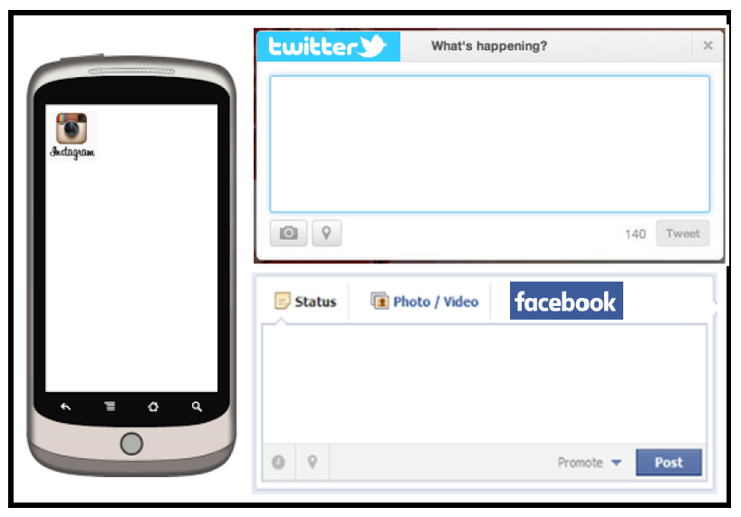
Social Media Plenary
Instagram: Draw a picture to represent what you have learnt in this learning phase.
Twitter: write a tweet about the learning phase. It can only be 140 characters (letters, spaces and symbols) and must include 1 hashtag (#)
Facebook: Write a Facebook status update about this learning phase.

