Slide 1

Health and well-being
Cyber bullying

Slide 2

Lesson aim:
  To look at what cyber bullying is and be able to identify it when it happens.
  To look at the way language and text can be misinterpreted as bullying.
  To look at ways of tackling cyber bullying in schools.

Slide 3

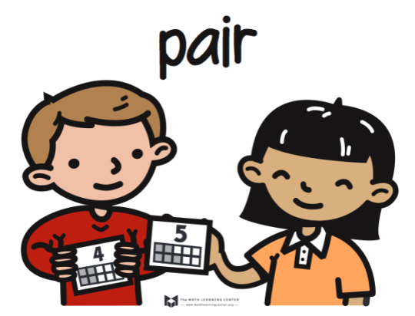

What does the term ‘cyber bullying’ mean?
Can you give any examples?
Think
Pair
Share

Slide 4
Cyber bullying
"Cyber-bullying" is when a child, preteen or teen is tormented, threatened, harassed, humiliated, embarrassed or otherwise targeted by another child, preteen or teen using the Internet, interactive and digital technologies or mobile phones.
It has to have a minor on both sides, or at least have been instigated by a minor against another minor. Once adults become involved, it is cyber-harassment.

Slide 5
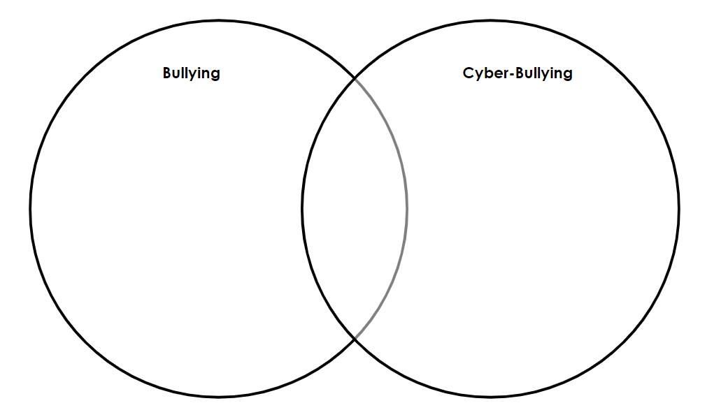
Compare bullying and cyber bullying using the venn diagram. How are they different? How are they similar?

Slide 7
What does the law say about cyber bullying?
There is no legal definition of cyberbullying within UK law.
However, there are a number of existing laws that can be applied to cases of cyberbullying and online harassment, namely:
  Protection from Harassment Act 1997
  Criminal Justice and Public Order Act 1994
  Malicious Communications Act 1988
  Communications Act 2003
  Breach of the Peace (Scotland)
  Defamation Act 2013

Slide 8
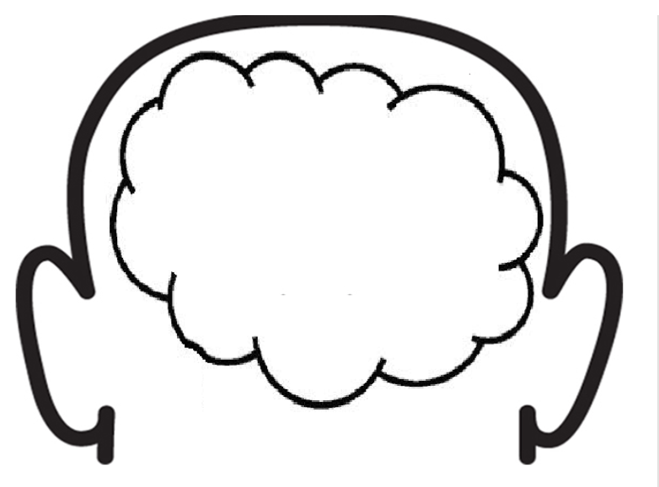
What can you do if you are a victim of cyber-bullying or if you see it happening to someone else? Write down your ideas…

Slide 9
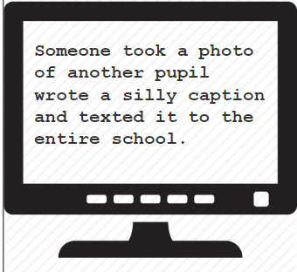
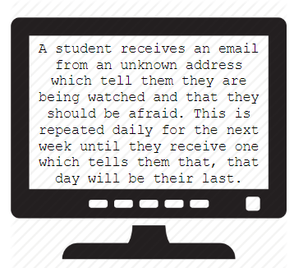
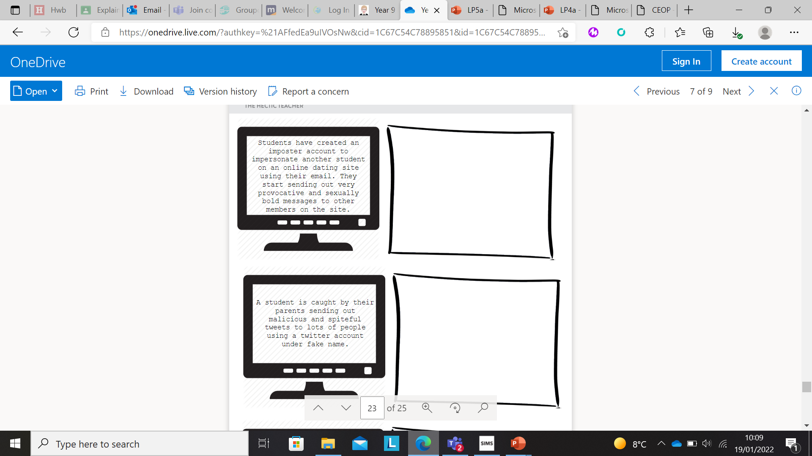
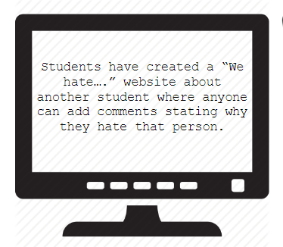
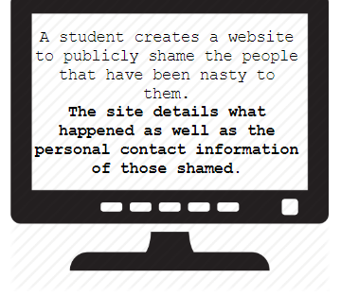
Look at each of the case studies and decide if you think this is an example of cyber-bullying or not and what you would do in this situation.

Slide 10

Pick TWO of the case studies and explain why you think it is cyber bullying and what you could do about the situation.
You could upload a video of your answer to Google Classroom or write it in your book.

Slide 11
Starter sentences
I have picked the following case study:
I think this IS cyber bullying because…
Another reason I believe this is…
Furthermore…
In this situation you could…
Another way to deal with the situation is…
Lastly…

Slide 12
Where can I go for help?
Speak to a teacher about it
Speak to someone at home or a friend
Tell your Head of Learning
Speak to Mrs Lisa Jones

Slide 13

PLENARY
Write down:
3 things you will remember from this lesson
2 things you have learnt today
1 question you have

